Slide 1
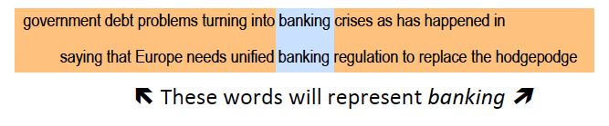
1.4.3 Word Embeddings
The neighborhood of a word expresses a lot about its meaning
“You shall know a word by the company it keeps” (J. R. Firth 1957)
Notes:
With latent semantic indexing we have exploited the idea that words that occur together in a document are likely to have some shared meaning. The idea that words occurring in a common context have a shared meaning is quite old and has been already stated by Firth in 1957.
Different to LSI we will in the following exploit this idea in different way. Instead of considering a complete document as the context of a word, we will consider only the immediate neighborhood of a word, in the spirit of the statement of Firth.

Slide 2
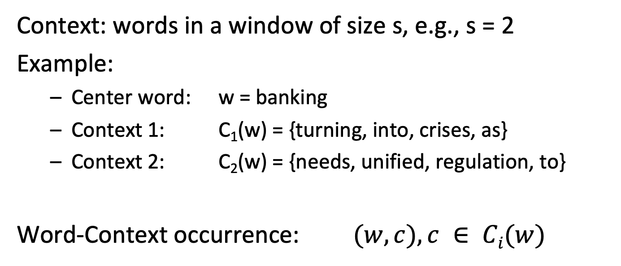
Word Context
Context: words in a window of size s, e.g., s = 2
Example:
Center word: w = banking
Context 1: C₁(w) = {turning, into, crises, as}
Context 2: C₂(w) = {needs, unified, regulation, to}
Word-Context occurrence: $(w, c), c ∈ Ci(w)$
Notes:
For a given word w we can identify its neighboring words, which will call its context and denote by C(w). The context can be determined by choosing a window of preceding and succeeding words. A typical window size used in practice would by n = 5. We will call the word w in the following center word and a word c a context word.
Since a word can occur multiple times, each occurrence of the word induces a new context. We will denote these contexts by C_{i}(w) with an index i running over all occurrences of a word in a document collection.

Slide 3
Similarity-Based Representation
One of the most successful ideas in natural language processing
Two words are considered as similar, when they have similar contexts
Context captures both syntactic and semantic similarity
Syntactic: e.g., king – kings
Semantic: e.g., king – queen
Implicitly used with the term-document matrix M
Less localized context
No distinction between roles of context and word
Notes:
The idea of context representing meaning is one of the most successful ideas in natural language processing. The neighborhood captures not only semantic relationships among words (as would co-occurrence in the same document). It, at the same time, also captured syntactic relationships. This is an important difference compared to methods based on document-level co-occurrence like LSI.
A second important difference is that methods based on this idea distinguish between a word occurring as the center word of a context and as a context word. For example, it is very unlikely the word “king” would have in its context a second occurrence of the word “king”. Thus, king as a “context word” needs to be treated differently from king as a center word. This distinction is not made in approaches based exclusively on co-occurrence statistics at the document level.

Slide 4
Idea: Word Embeddings
Model how likely a word and a context occur together
Approach:
Map words into a low-dimensional space (e.g., d = 200)
Map context words into the same low-dimensional space
A different mapping for the same words
Interpret the vector distance (product) as a measure for how likely the word and its context occur together
Due to projection in low-dimensional space, semantically and syntactically related words and contexts should be close
Notes:
The basic idea for word embeddings is straightforward. Both, center words and context words, are mapped into a low-dimensional space of the same dimension. Their representations in that space should be similar, if the center word and the context word occur frequently together. Thus, we capture the information on word context in a low-dimensional representation. Using dimensionality reduction, the expectation is that words and contexts that play similar roles would also be close to each other and would capture syntactic and semantic similarity.
Dimensionality reduction is helpful, since vocabularies can become very large. This is especially true when not only words, but also short phrases are considered. Thus, data would be very sparse in the original vocabulary space, and it would be difficult to represent similarity.

Slide 5

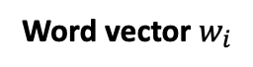
Mapping to Concept Space
Vocabulary $T$ of size $m$
Words $w_{i}∈T$ are encoded as “1-hot vectors” of length $m$, i.e., the component at position $i$ is $1$ all others are $0$
Word vector $w_{i}$
0
0
.
.
1
.
.
0
0
0
0
Position i
Notes:
We introduce now the representations of center words and context words in an m-dimensional space. The representation where the i-th component of a vector is set to 1 for the i-th word in the vocabulary is called often the 1-hot encoding of the word.

Slide 6
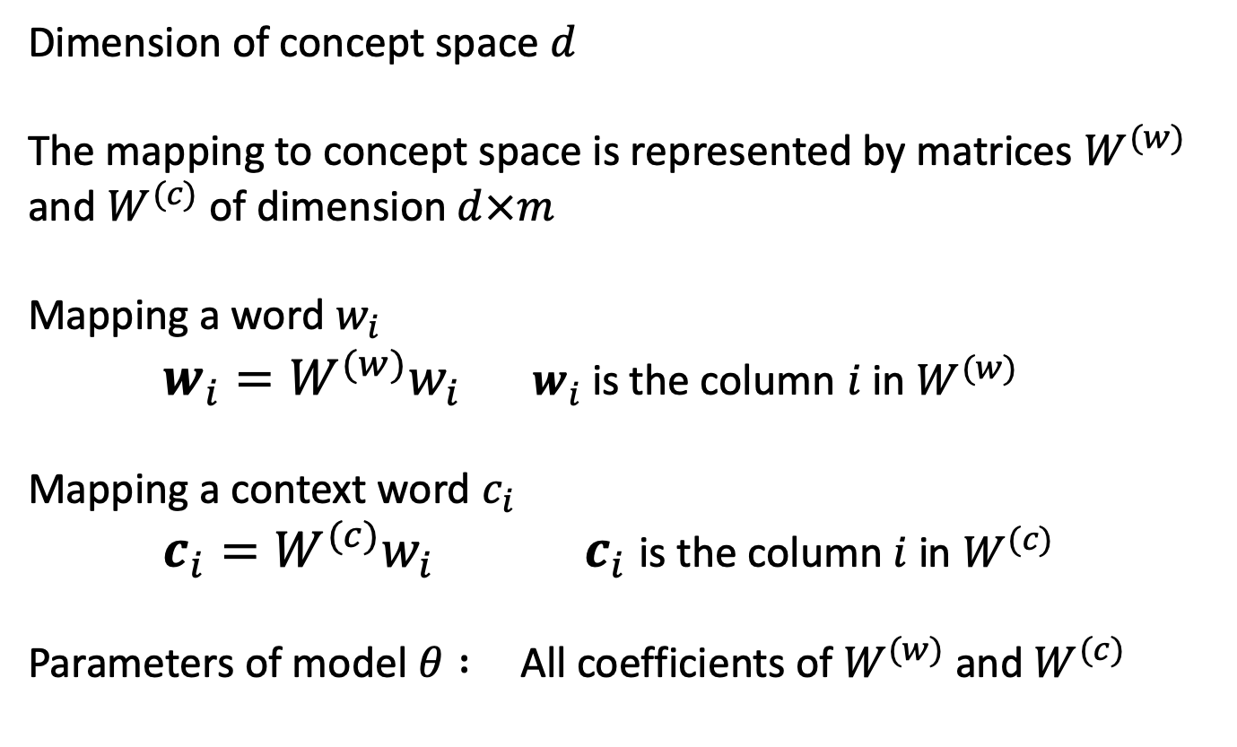
Model Parameters
Dimension of concept space $d$
The mapping to concept space is represented by matrices $W^{(w)}$ and $W^{(c)}$ of dimension $d×m$
Mapping a word $w_{i}$
$w_{i}=W^{(w)}w_{i} { w}_{i}$is the column $i$ in $W^{(w)}$
Mapping a context word $c_{i}$
$c_{i}=W^{(c)}w_{i} { c}_{i}$is the column $i$ in $W^{(c)}$
Parameters of model $θ :$All coefficients of $W^{(w)}$ and $W^{(c)}$
Notes:
For creating a word embedding we first choose a dimension that is significantly lower than the size of the vocabulary. Typical values of the dimension are in the hundreds, whereas vocabularies can have millions of terms.
In order to map a 1-hot vector from the vocabulary space into the word embedding space, we apply linear mappings represented by a matrices W^{(w)} and W^{(c)}. As mentioned before. the mappings for center words and context words are different.
Note that the i-th columns of the matrices correspond exactly to the word embedding representations of the i-th word in the vocabulary.
For notational convenience we will denote in the following the combined set of coefficients of the two matrices also by $θ$.

Slide 7
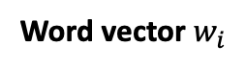
Illustration
Scalar product
m
0
0
.
.
1
.
.
0
0
0
0
Position i
d
W^{(w)}
•
m
d x m
Word vector $w_{i}$
Columns represent words of the vocabulary in concept space
Notes:
Here we illustrate the mapping of words into concept space graphically. Since the word vectors use the 1-hot encoding, we observe that the columns of the matrix W^{(w)} in fact are exactly the representation of the center words in the concept space. The same holds also for the mapping of context words.

Slide 8

Question
A row of matrix $W^{(c)}$ represents
How relevant word $c$ is for each dimension
How often a context word $c$ co-occurs with all words
A representation of word $c$ in concept space

Slide 9
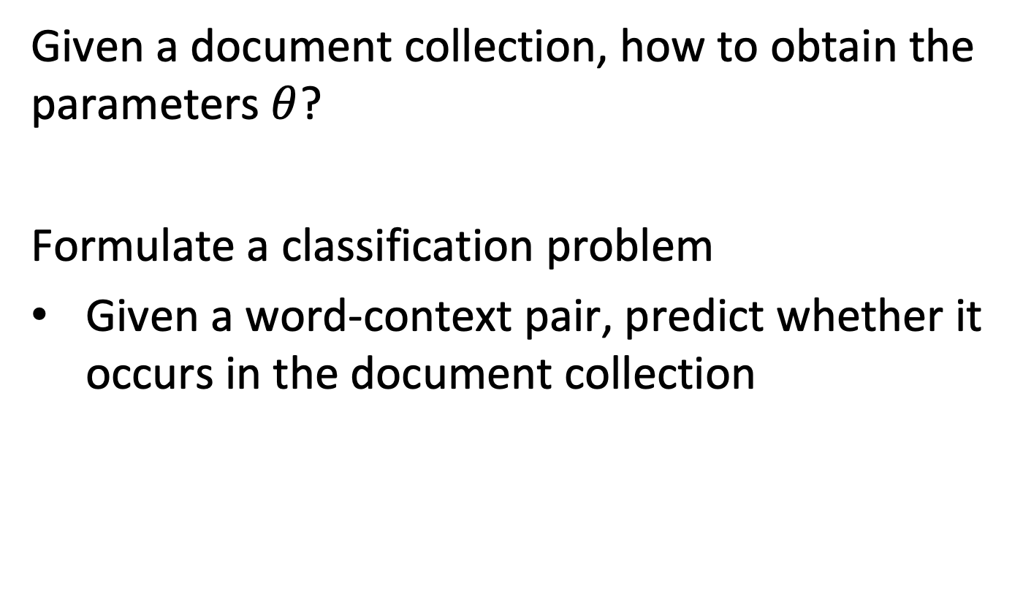
Learning the Model from Data
Given a document collection, how to obtain the parameters $θ$?
Formulate a classification problem
Given a word-context pair, predict whether it occurs in the document collection
Notes:
The problem we face now, is how to determine the model parameters, given a document collection.
We can approach this by introducing learning problem. We want to be able to predict whether a given word-context pair occurs in the document collection. By solving this problem, we will obtain the embedding parameters.

Slide 10
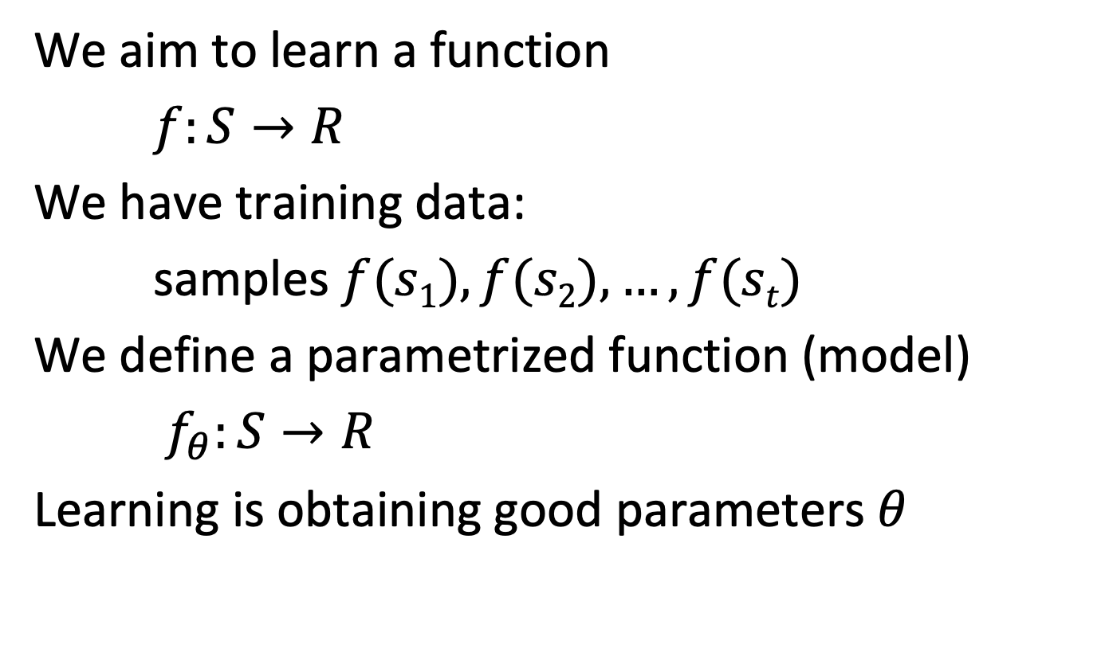
Statistical Learning
We aim to learn a function
$f:S→R$
We have training data:
samples $f(s1), f(s2), …, f(st)$
We define a parametrized function (model)
$f_{θ}:S→R$
Learning is obtaining good parameters $θ$
Notes:
Before we introduce in detail, how to obtain the parameters for the word embedding, let’s first recall the principles of the approach we are going to use, statistical learning.
The general setting of statistical learning is to obtain an approximation of a given function f, from some sample values of the function that are known. The function f is approximated by a function $f_{θ}$ that has a given form and contains a set of parameters $θ$. By optimizing the parameters $θ$ we obtain the function approximation. The optimization step is what is generally called learning.
A standard example of statistical learning is linear regression.

Slide 11
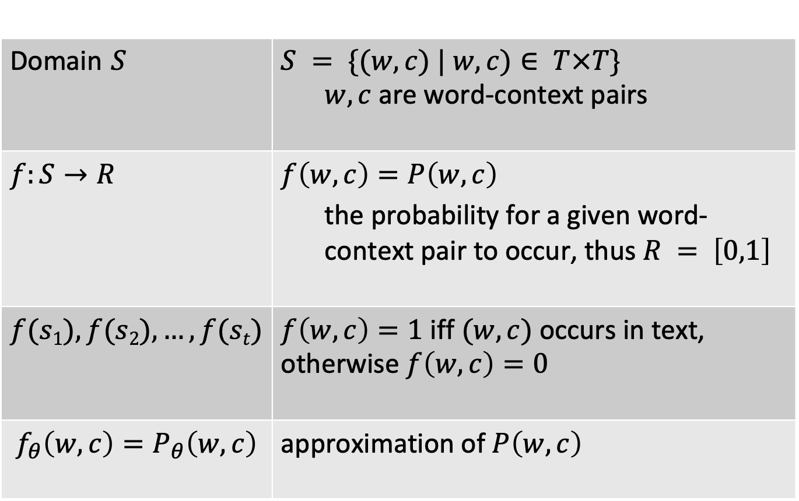
Word Context Learning Problem
Domain $S$ | $$S = \{(w,c) | w,c)∈ T×T\}$$ $w,c$ are word-context pairs
$f:S→R$ | $$f\left(w,c\right)=P\left(w,c\right)$$ the probability for a given word-context pair to occur, thus $R = \left[0,1\right]$
$$f(s1), f(s2), …, f(st)$$ | $f\left(w,c\right)=1$ iff $(w,c)$occurs in text, otherwise $f\left(w,c\right)=0$
$$f_{θ}\left(w,c\right)=P_{θ}\left(w,c\right)$$ | approximation of $P\left(w,c\right)$
Notes:
Given that we want to predict whether a word-context pair occurs in a document collection, the statistical learning problem we formulate is for a function that takes as input word-context pairs and returns as output a probability for that this pair occurs in the documents. The samples from which we learn are derived from the document collection. For word-context pairs that occur in the collection we set the function value to 1, and for any pair that does not occur, we can set it to 0. The problem is then to find a function $f_{θ}$ that approximates well the original probability distribution $P$. We have now to determine what form the function $f_{θ}$ can take, and how the quality of approximation is measured.

Slide 12
Representation Learning
A learning algorithm that creates for some input data a new representation with desirable properties
Most often the representation is in a vector space
For example, represent words of a vocabulary as vectors
Idea: create the word embeddings using representation learning
Notes:
So far, the idea of using statistical learning does not explain how we would obtain word embedding representations. To this end, we introduce now another concept, which is called representation learning. Representation learning aims at creating a new representation of input data, into a space of interest and with useful properties. Most often, the space for representation is a vector space.
In order to obtain the representations as a by-product of solving a statistical learning problem, the “trick” is to create a function $f_{θ}$ that is based on the desired representations of the input data, in our case on the vector representations of the words. As a result, the “real objective” of solving the previous learning problem is no longer doing good predictions for the function $f$, but obtaining the vector representations.

Slide 13
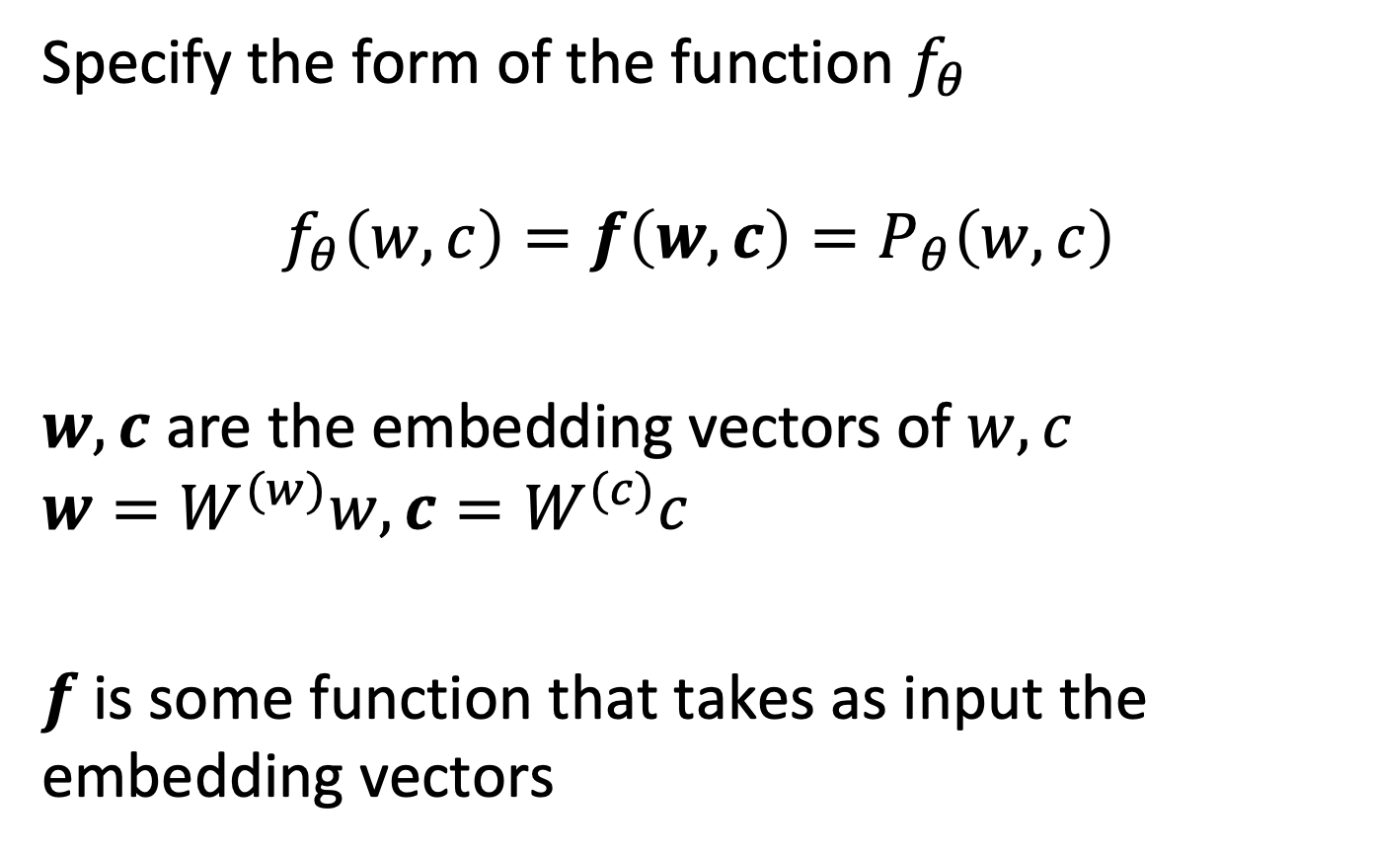
Word Embedding Learning Problem
Specify the form of the function $f_{θ}$
$$f_{θ}\left(w,c\right)=f\left(w,c\right)=P_{θ}\left(w,c\right)$$
$w,c \text{are} \text{the} \text{embedding} \text{vectors} \text{of} w,c$ $$w=W^{(w)}w, c=W^{(c)}c$$
$f$is some function that takes as input the embedding vectors
Notes:
The function $f_{θ}$ we learn has a specific form: it first maps the words into a vector space, their representation, and then applies another function $f$ for approximating the probabilities.
Note that the function$f$ is using as input the vector representations of the words. The matrices $W^{(w)}$ and $W^{(c)}$ are therefore part of the parameters of the function $f_{θ}$.

Slide 14
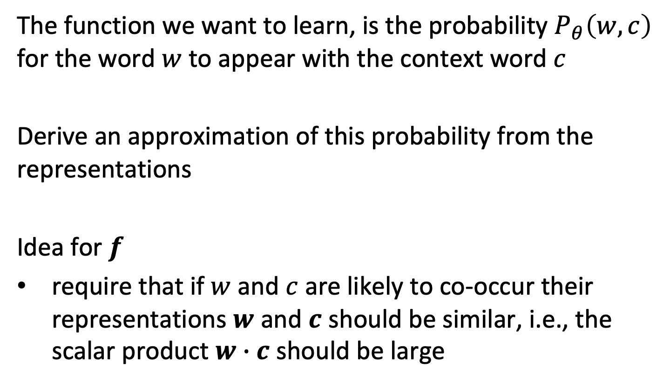
Properties of Embeddings
The function we want to learn, is the probability $P_{θ}\left(w, c\right)$ for the word $w$ to appear with the context word $c$
Derive an approximation of this probability from the representations
Idea for $f$
require that if $w$ and $c$ are likely to co-occur their representations $w$ and $c$ should be similar, i.e., the scalar product $w∙c$ should be large
Notes:
So far, we have not imposed any specific constraint on the function $f$ that is applied to the embedding vectors. Now we come back to the requirement that low-dimensional representations of words should be similar, if they have a close semantic or syntactic relationship. If consider co-occurrence as a word-context pair as an indicator for such a relationship, we could also state the related requirement that the low-dimensional representations of center words and context words should be similar. This is the approach we will consider in the following.
For determining similarity of vector representations, we can rely on a well-known approach, the use of the scalar product.

Slide 15
Illustration
Banking (word)
Crisis (context word)
Debt (context word)
Banking • Crisis = +3
Banking • Debt= +2
Banking • Monkey = -1
Monkey (context word)
Notes:
Here we illustrate the embedding of words and context words in the same low-dimensional space. The idea is that the context words that typically co-occur together with a word, have similar embedding vectors, whereas others (like monkey, which is rarely occurring together with bank) have very different ones.

Slide 16
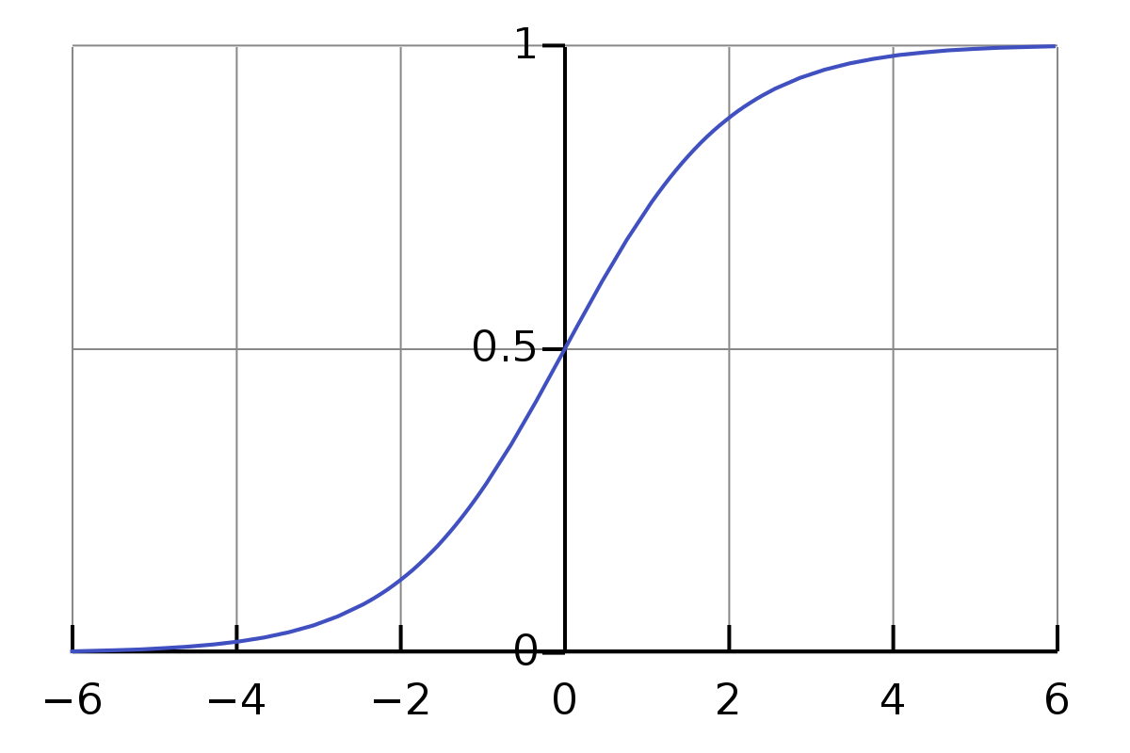
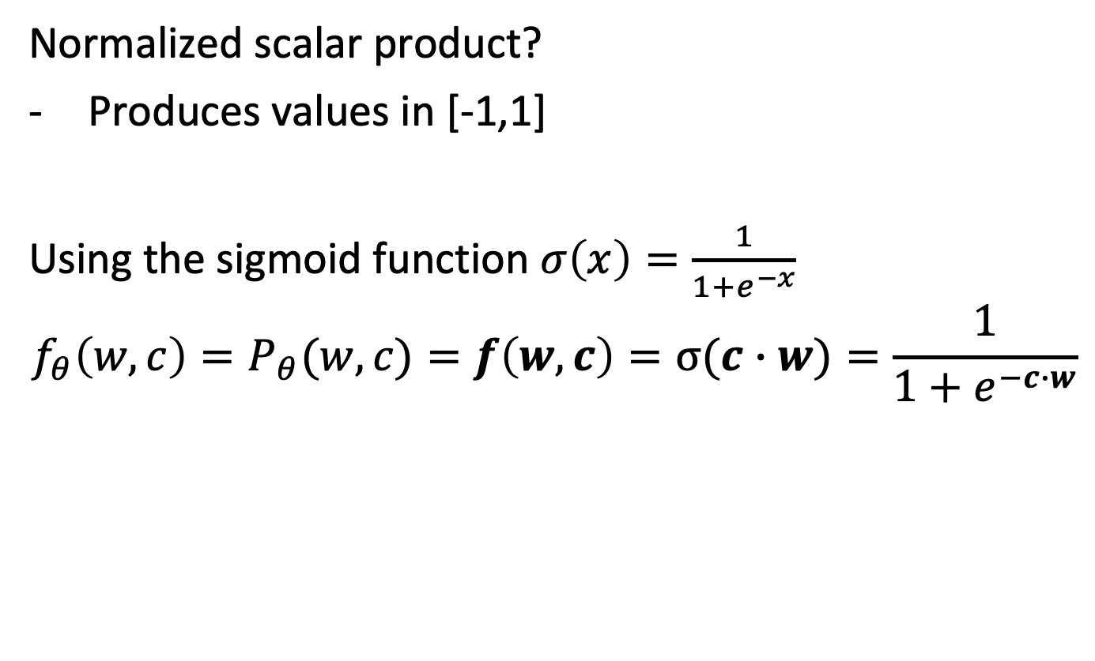
Deriving Probabilities
Normalized scalar product?
Produces values in [-1,1]
Using the sigmoid function $σ\left(x\right)=\frac{1}{1+e^{−x}}$
$${f_{θ}\left(w,c\right)=P}_{θ}(w,c)=f\left(w,c\right)=σ(c∙w)=\frac{1}{1+e^{−c∙w}}$$
Notes:
Since we have formulated the learning problem as a prediction of probabilities, the range of values of the learnt function $f_{θ}$ should fall into the interval [0,1]. Using the scalar product, even if we use normalize by using cosine similarity, does not achieve this.
Therefore, a common function to map real values into the interval [0,1] is used, the sigmoid function. The sigmoid function has other useful properties, in particular, it is differentiable.
This results in the final structure of the function $f_{θ}$ we learn. It is fully specified by its parameters $θ$.

Slide 17
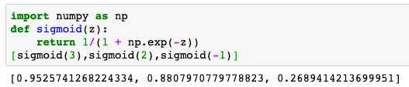
Illustration
Banking (word)
Crisis (context word)
Debt (context word)
Banking • Crisis = +3
Banking • Debt= +2
Banking • Monkey = -1
P(Banking, Crisis) = 0.95
P(Banking, Debt= 0.88
P(Banking, Monkey) = 0.27
Monkey (context word)
Notes:
Here we illustrate how by applying the softmax function to the scalar product of the embedding vectors results in probabilities predicting the occurrence of word-context pairs.

Slide 18
Question
From which data samples the embeddings are learnt?
Known embeddings for (w,c) pairs
Frequency of occurrences of (w,c) pairs in the document collection
Approximate probabilities of occurrences of (w,c) pairs
Presence or absence of (w,c) pairs in the document collection

Slide 19
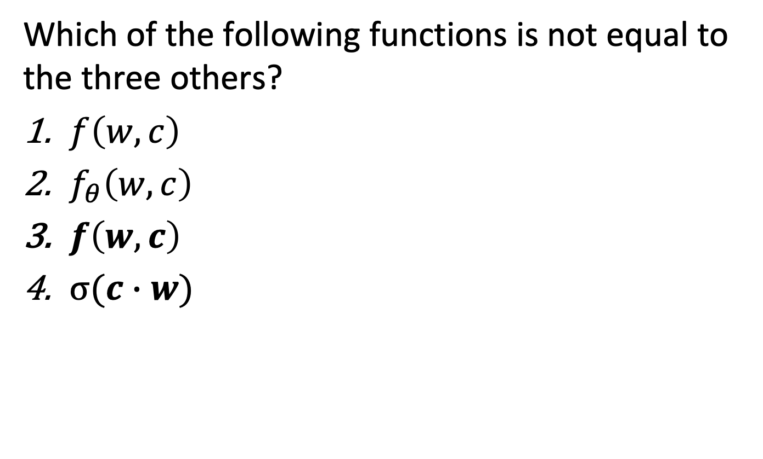
Question
Which of the following functions is not equal to the three others?
$f\left(w,c\right)$
$f_{θ}\left(w,c\right)$
$f\left(w,c\right)$
$σ(c∙w)$

Slide 20
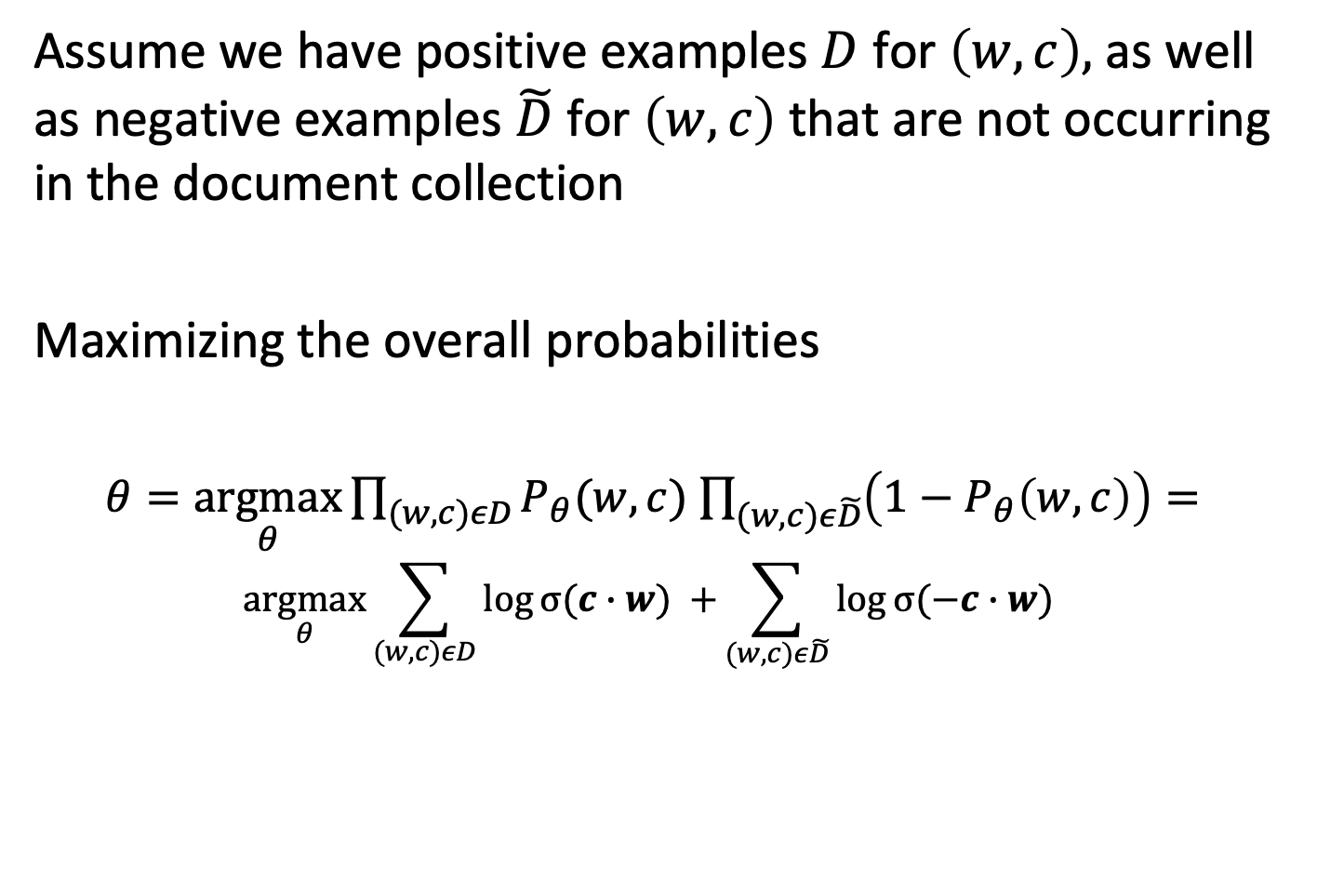
Learning the Parameters
Assume we have positive examples $D$ for $\left(w,c\right),$as well as negative examples $\tilde{D}$ for $\left(w,c\right)$ that are not occurring in the document collection
Maximizing the overall probabilities
$θ=\underset{θ}{argmax}{\prod_{(w,c)εD}{P_{θ}(w,c)}}$ $\prod_{(w,c)ε\tilde{D}}{\left(1−P_{θ}\left(w,c\right)\right)=}$
$$\underset{θ}{argmax}\sum_{(w,c)εD}{\log{σ(c∙w) }+}\sum_{(w,c)ε\tilde{D}}{\log{σ(−c∙w) }}$$
Notes:
Now that we have defined the structure of the function we want to learn, we must perform the learning. To that end, we formulate an optimization problem which states that learning consists of finding the optimal parameters $θ$ for achieving the highest predicted probability for the available data. The available data consists of samples of word-context pairs. There exist two types of such samples, first, word-context pairs that occur in the text collection and thus must have a high probability to occur, and word-context pairs that do not occur in the document collection and thus must have a low probability. We cannot assume that we achieve perfect prediction of those probabilities, i.e., values of 0 and 1, under the specific choice of the function $P_{θ}$ we decided to learn. Therefore, we try to maximize the product of the probabilities of the positive samples and the complement of the probabilities of the negative samples.
The optimization problem can be reformulated by taking the logarithm of the expression to be optimized. This is a standard operation to make the optimization problem easier to treat from an algebraic and numerical perspective.

Slide 21
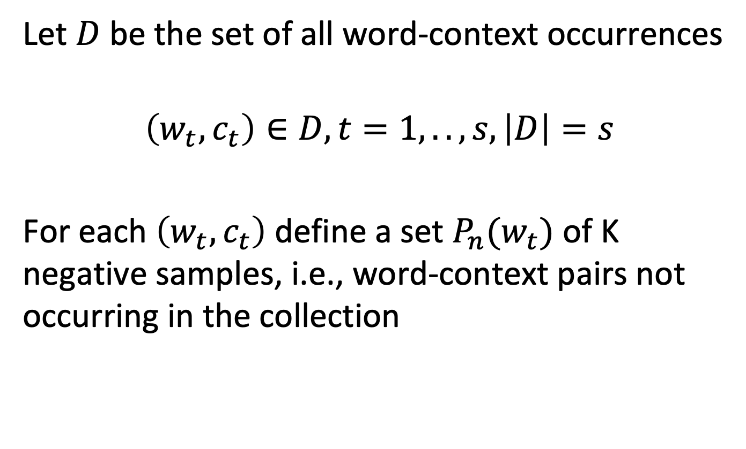
Positive and Negative Samples
Let $D$ be the set of all word-context occurrences
$$\left(w_{t}, c_{t}\right)∈D, t=1,..,s, \left|D\right|=s$$
For each $\left(w_{t}, c_{t}\right)$ define a set $P_{n}(w_{t})$ of K negative samples, i.e., word-context pairs not occurring in the collection
Notes:
Here we describe the approach for obtaining the positive and negative samples. We consider the set D to be the set of all word-context occurrences in the document collection. For each element of D we then choose a set of negative samples of a given size s. This set consists of word-context pairs that do not occur in the collection. We will describe a concrete approach for selecting such negative samples later.

Slide 22
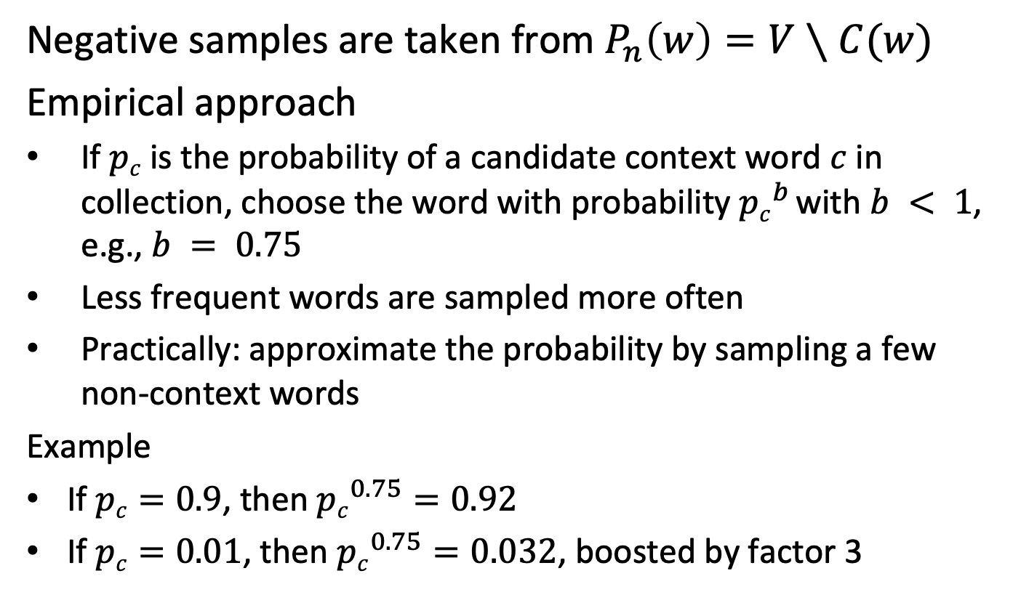
Obtaining Negative Samples
Negative samples are taken from $P_{n}\left(w\right)=V∖C(w)$
Empirical approach
If $pc$ is the probability of a candidate context word $c$ in collection, choose the word with probability ${pc}^{b}$ with $b < 1$, e.g., $b = 0.75$
Less frequent words are sampled more often
Practically: approximate the probability by sampling a few non-context words
Example
If $pc=0.9$, then ${pc}^{0.75}=0.92$
If $pc=0.01$, then ${pc}^{0.75}=0.032$, boosted by factor 3
Notes:
A concrete method to obtain the negative samples is described now. For a given word w from the vocabulary V, the context words for negative samples are chosen from all words that do not occur as context word of w. This could be done, for example, uniformly at random. However, with such choice high frequency words would have too much influence on the learning process, whereas low- frequency words would not be sufficiently considered. Therefore, based on empirical evaluation, it turns out that it is of advantage to favor low frequency words. The probability to choose a context word is thus biased towards low frequency words, by attenuating higher probabilities with an exponent $b<1$. In this way, less frequent words will be considered more frequently.
In order to apply this approach, the word frequencies in the collection of words not occurring in the context need to be known. Since computing this statistics for every word separately would be expensive, in practice it is obtained by sampling.

Slide 23
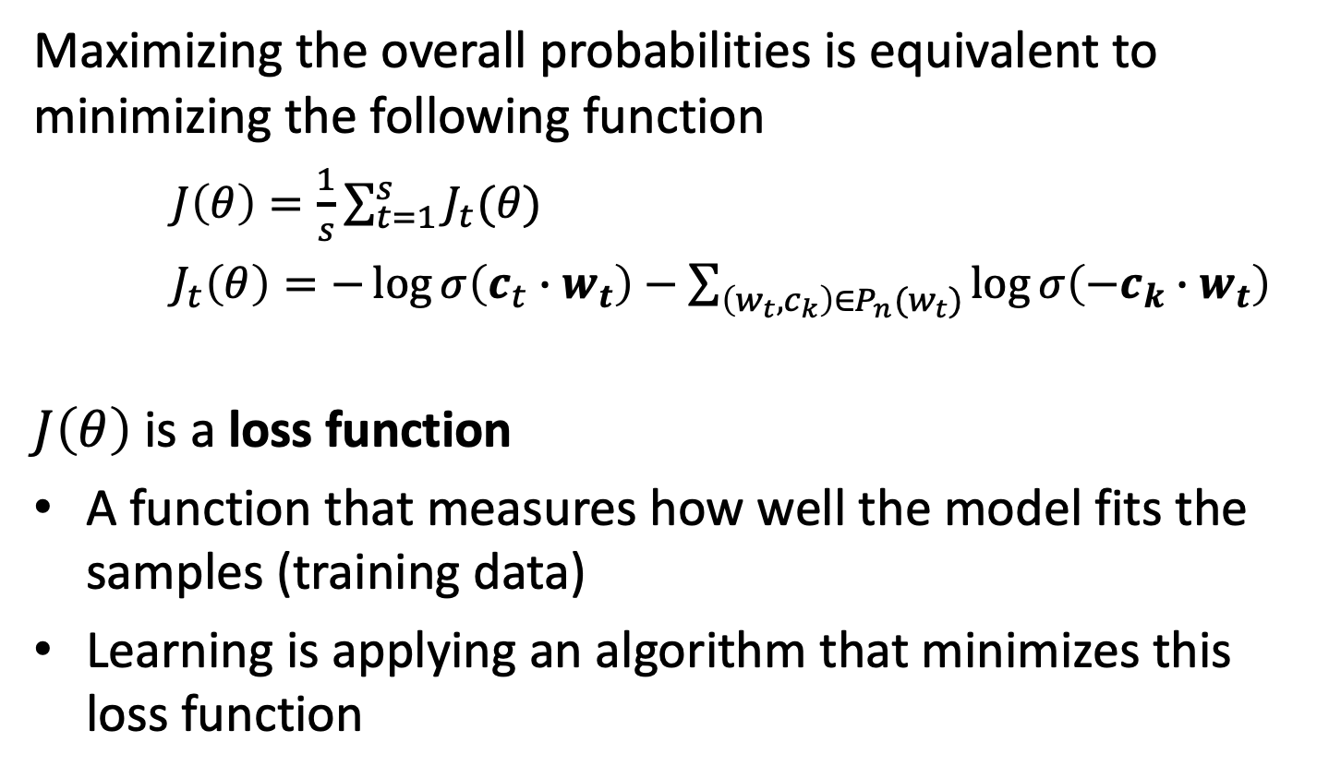
Loss Function
Maximizing the overall probabilities is equivalent to minimizing the following function
$J\left(θ\right)=\frac{1}{s}\sum_{t=1}^{s}{J_{t}(θ)}$
$J_{t}\left(θ\right)=−\log{σ\left(c_{t}∙w_{t}\right)}−\sum_{\left(w_{t}, c_{k}\right)∈P_{n}(w_{t})}{\log{σ\left(−c_{k}∙w_{t}\right)}}$
$J\left(θ\right)$ is a loss function
A function that measures how well the model fits the samples (training data)
Learning is applying an algorithm that minimizes this loss function
Notes:
Having defined the set of positive and negative samples, we can further reformulate the optimization problem for learning the parameters $θ$. We convert the maximization problem to a minimization problem, which is the conventional formulation of learning problems, and replace the specific choice of samples. This allows to decompose the function to be optimized into a sum of functions $J_{t}\left(θ\right)$, corresponding to the positive samples $\left(w_{t}, c_{t}\right)$. This decomposition will be important in the following for the method used to solve the optimization problem.
According to the standard terminology in machine learning, $J\left(θ\right)$ is called the loss function, and is a function that needs to be minimized in order to solve the optimization resp. learning problem.

Slide 24
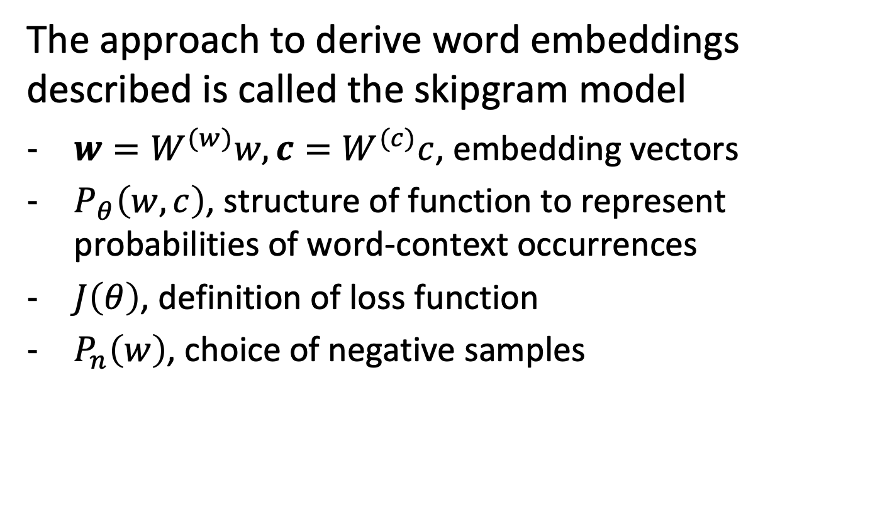
Skipgram Model with Negative Sampling
The approach to derive word embeddings described is called the skipgram model
$w=W^{(w)}w, c=W^{(c)}c$, embedding vectors
$P_{θ}\left(w,c\right)$, structure of function to represent probabilities of word-context occurrences
$J\left(θ\right)$, definition of loss function
$P_{n}\left(w\right)$, choice of negative samples
Notes:
The different elements for defining an optimization problem to learn the embedding vectors that we have introduced correspond to one specific word embedding model which is called the skipgram model with negative sampling. Note the several choices that are made, in particular on the structure of the probability function, the specific loss function and the choice of negative samples.

Slide 25
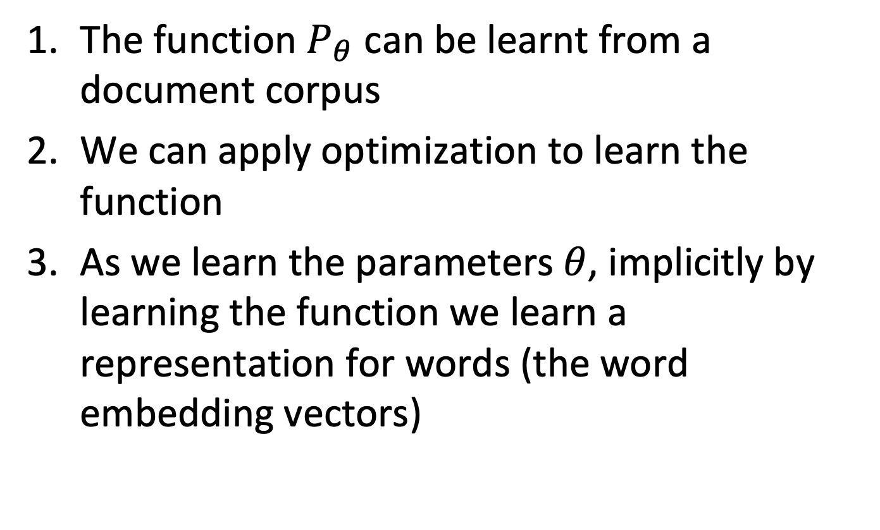
Observations
The function $P_{θ}$ can be learnt from a document corpus
We can apply optimization to learn the function
As we learn the parameters $θ$, implicitly by learning the function we learn a representation for words (the word embedding vectors)
Notes:
We have not set up a formulation of an optimization problem that can be solved for any given document collection. By solving the optimization problem, we will obtain as a side effect the embedding vectors. This, in fact, has been the initial objective of defining the learning problem. What remains to be seen is of how concretely the optimization problem can be solved.

Slide 26
Question
With negative sampling a set of negative samples is created for
For each word of the vocabulary
For each word-context pair
For each occurrence of a word in the text
For each occurrence of a word-context pair in the text

Slide 27
Question
The loss function is minimized
By modifying the word embedding vectors
By changing the sampling strategy for negative samples
By carefully choosing the positive samples
By sampling non-frequent word-context pairs more frequently

Slide 28

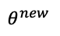
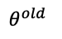
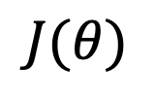
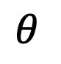
Solving the Learning Problem
Gradient Descent: compute using all samples
$θ^{new}=$ $θ^{old}−α∇_{θ}J (θ^{old}$)
$$J(θ)$$
$$θ$$
$$θ^{old}$$
$$θ^{new}$$
Notes:
Given the loss function, finding the optimal parameters $θ$ can then be achieved by applying standard methods from machine learning. Concretely, $θ$ can be determined using gradient descent, a standard method for searching the minima of a function using derivatives. Gradient descent is an iterative approach for locally improving a current minimum. By following the local gradient, the optimal value is incrementally updated till it converges to a (local) minimum.

Slide 29
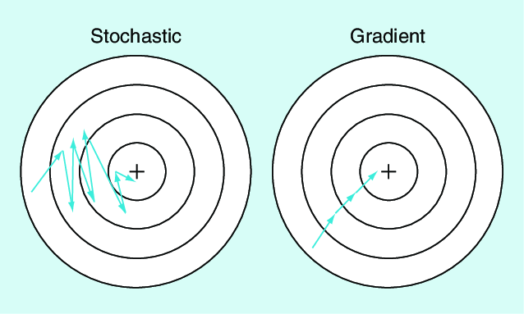

Stochastic Gradient Descent (SGD)
For every $\left(w_{t},c_{t}\right)∈D$, update $θ$ separately
$θ^{new}=$ $θ^{old}−α∇_{θ}J_{t}(θ^{old}$)
Notes:
In basic gradient descent, the parameters are updated based on the complete data (set of samples). In stochastic gradient descent, the parameters are updated for a randomly selected subset of the data. Therefore, the decomposition of the loss function into component functions corresponding to each element of the data was useful. In our case we update the parameters for each word-context pair separately. With stochastic gradient we reduce the cost of each iteration, but on the other hand slow down the convergence rate. In practice, using SGD is the standard method of learning with complex loss functions.

Slide 30
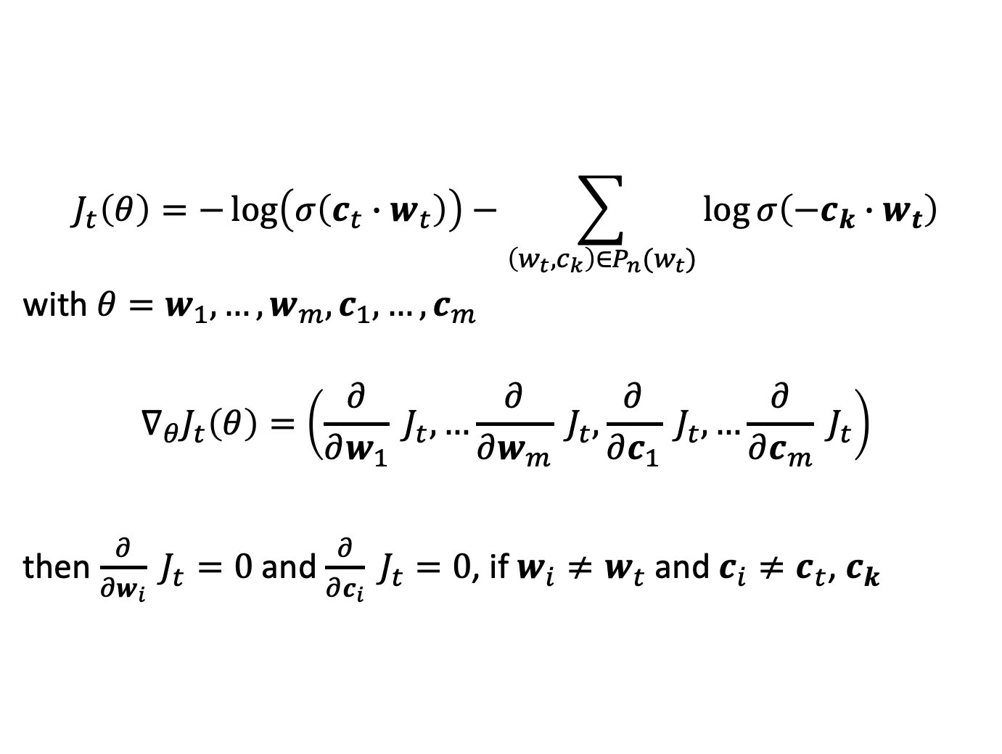
Computing the Derivatives
$$J_{t}\left(θ\right)=−\log\left(σ\left(c_{t}∙w_{t}\right)\right)−\sum_{\left(w_{t}, c_{k}\right)∈P_{n}(w_{t})}{\log{σ\left(−c_{k}∙w_{t}\right)}}$$ with $θ=w_{1},…,w_{m},c_{1},…,c_{m}$
$$∇_{θ}J_{t}\left(θ\right)=\left(\frac{∂}{∂w_{1}} J_{t},…\frac{∂}{∂w_{m}} J_{t},\frac{∂}{∂c_{1}} J_{t},…\frac{∂}{∂c_{m}} J_{t}\right)$$
then $\frac{∂}{∂w_{i}} J_{t}=0$ and $\frac{∂}{∂c_{i}} J_{t}=0$, if $w_{i}≠w_{t}$ and $c_{i}≠c_{t}$, $c_{k}$
Notes:
When stochastic gradient descent is used, only columns of the matrices $θ$ that contain the word, or a context word related to the current word-context pair and its negative samples need to be updated. This implies that the data must be organized that these rows can be efficiently accessed (e.g., using hashing).

Slide 31
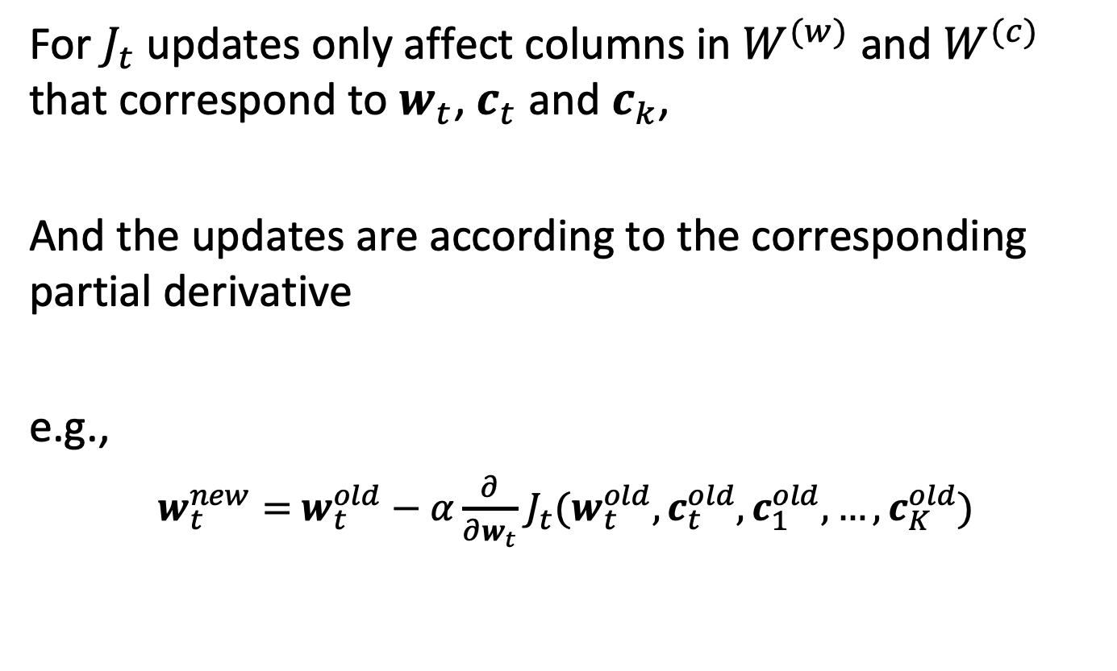
Updating the Model Parameters
For $J_{t}$ updates only affect columns in $W^{(w)}$ and $W^{(c)}$ that correspond to $w_{t}$,${ c}_{t}$ and $c_{k}$,
And the updates are according to the corresponding partial derivative
e.g.,
$w_{t}^{new}=$ $w_{t}^{old}−α\frac{∂}{∂w_{t}}$ $J_{t}(w_{t}^{old},c_{t}^{old},c_{1}^{old},…,c_{K}^{old})$
Notes:
The embedding vectors of a word are affected only by the derivatives of the loss function with respect to the word vector.

Slide 32
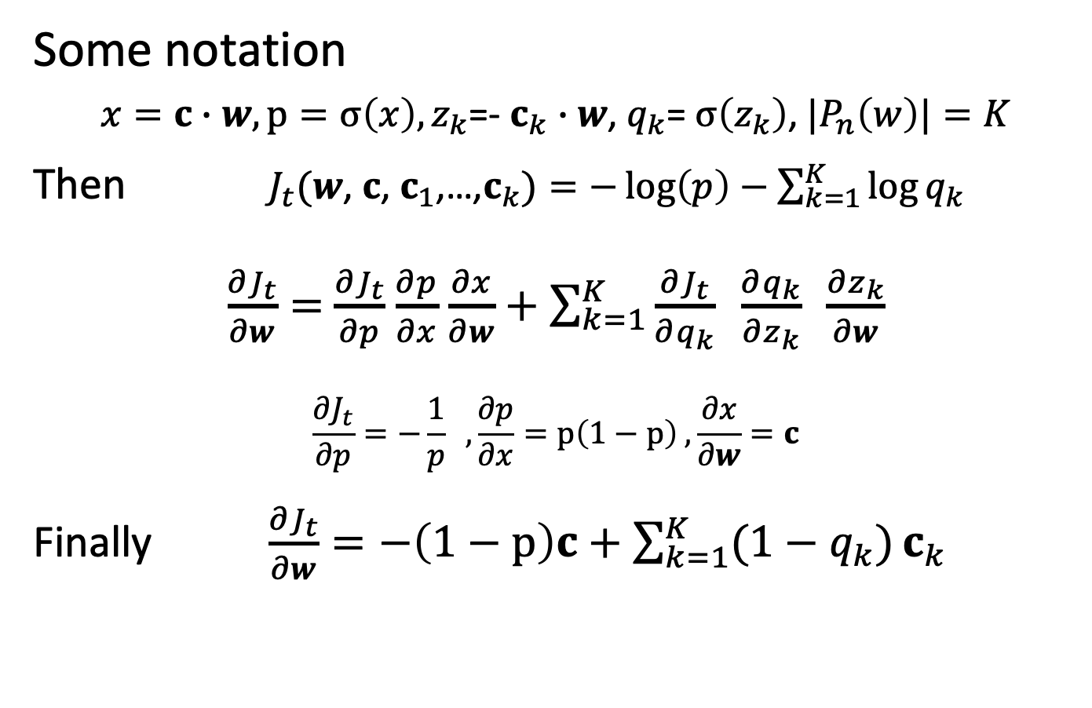
Computing the Derivative (Backpropagation)
Some notation
$x=c∙$ $w, p=σ\left(x\right),z_{k}$=- $c_{k}$ $∙$ $w$, $q_{k}$= $σ\left(z_{k}\right)$, ${|P}_{n}\left(w\right)|=K$
Then $J_{t}(w$, $c$, $c_{1}$,…,$c_{k})=−\log\left(p\right)−$ $\sum_{k=1}^{K}{\log{q_{k}}}$
$\frac{∂J_{t}}{∂w}=$ $\frac{∂J_{t}}{∂p}$ $\frac{∂p}{∂x}$ $\frac{∂x}{∂w}+\sum_{k=1}^{K}{\frac{∂J_{t}}{∂q_{k}} \frac{∂q_{k}}{∂z_{k}} \frac{∂z_{k}}{∂w}}$
$$\frac{∂J_{t}}{∂p}=−\frac{1}{p} ,\frac{∂p}{∂x}=p\left(1−p\right) , \frac{∂x}{∂w}=c$$
Finally $\frac{∂J_{t}}{∂w}=−\left(1−p\right)c+\sum_{k=1}^{K}{(1−q_{k})}c_{k}$
Notes:
Computing the derivative of the loss function, for updating the model parameters, requires evaluating derivatives along the operators that compose the loss function. This step is part of what is in machine learning commonly called backpropagation. We illustrate the essential steps of this computation for computing the derivative for a given word $\frac{∂J_{t}}{∂w}$. To that end, it is helpful to identify the different components that constitute the loss function and compose then the derivatives of those components using the chain rule. This reveals that the updates to the parameters result in simple operations. As an exercise one can complete the computation for the other derivatives.
.

Slide 33
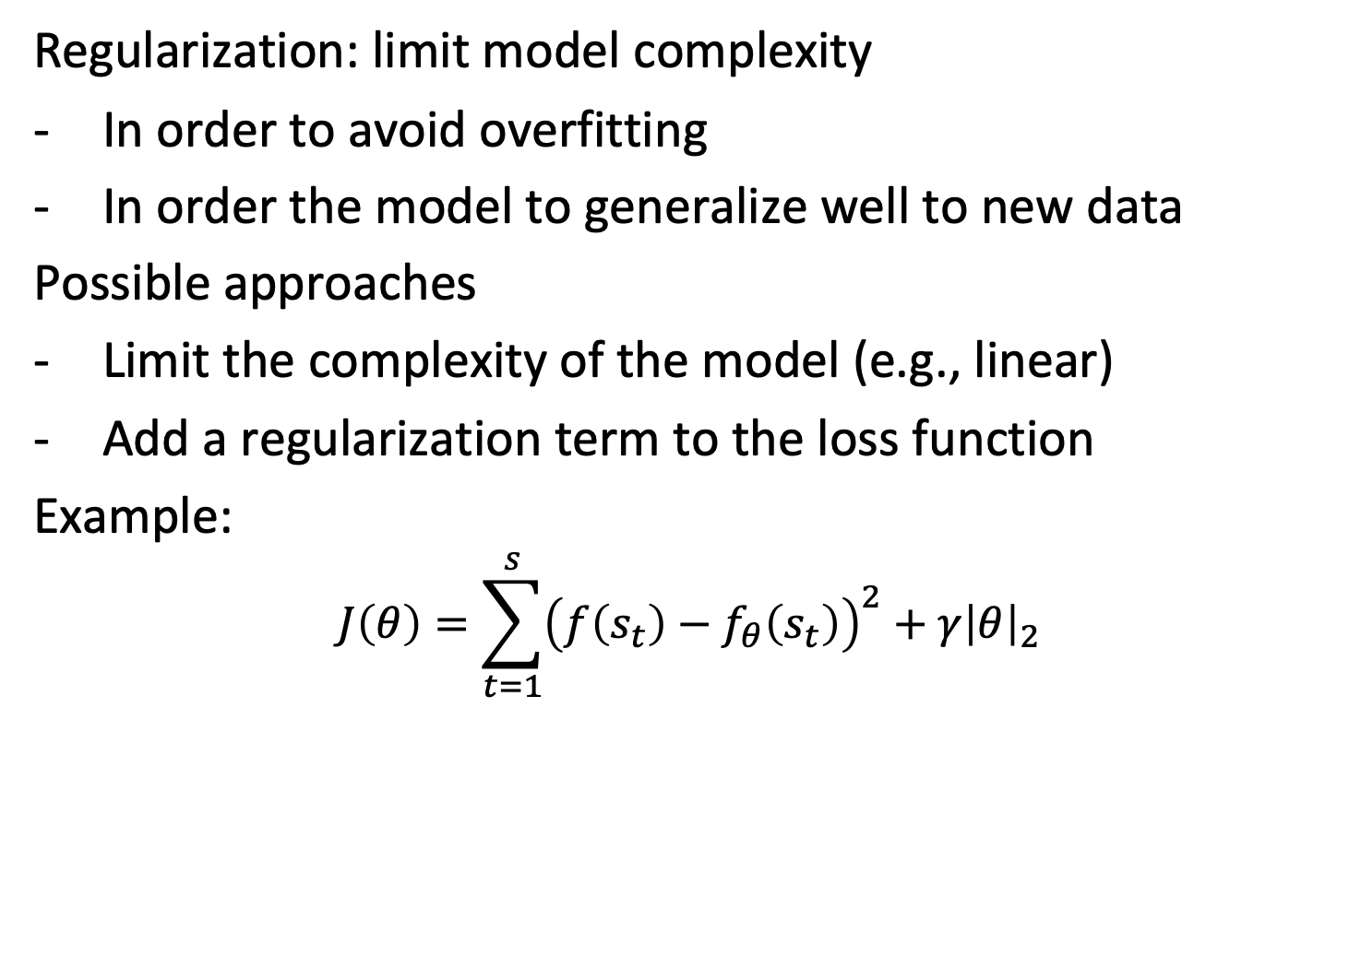
Regularization
Regularization: limit model complexity
In order to avoid overfitting
In order the model to generalize well to new data
Possible approaches
Limit the complexity of the model (e.g., linear)
Add a regularization term to the loss function
Example:
$$J\left(θ\right)=\sum_{t=1}^{s}{{\left(f\left(s_{t}\right)−f_{θ}\left(s_{t}\right)\right)}^{2}}+γ{\left|θ\right|}_{2}$$
Notes:
One key problem in statistical learning (or machine learning) is overfitting. If we provide a large number of parameters $θ$ we can easily learn a good, or even perfect approximation of the function applied to the training data, but the function will perform poorly on new data. Therefore, the idea is to “limit” the amount of information that can be stored in the model parameters, by minimizing some measure on them by including it into the loss function. This is called regularization. In the method we have introduced for deriving word embeddings no regularization is applied. The reason is that a linear model is nto considered to be a complex model and therefore the risk of overfitting is limited.

Slide 34
Question
A word embedding for given corpus …
depends only on the dimension d
depends on the dimension d and number of iterations in gradient descent
depends on the dimension d, number of iterations and chosen negative samples
there are further factors on which it depends

Slide 35
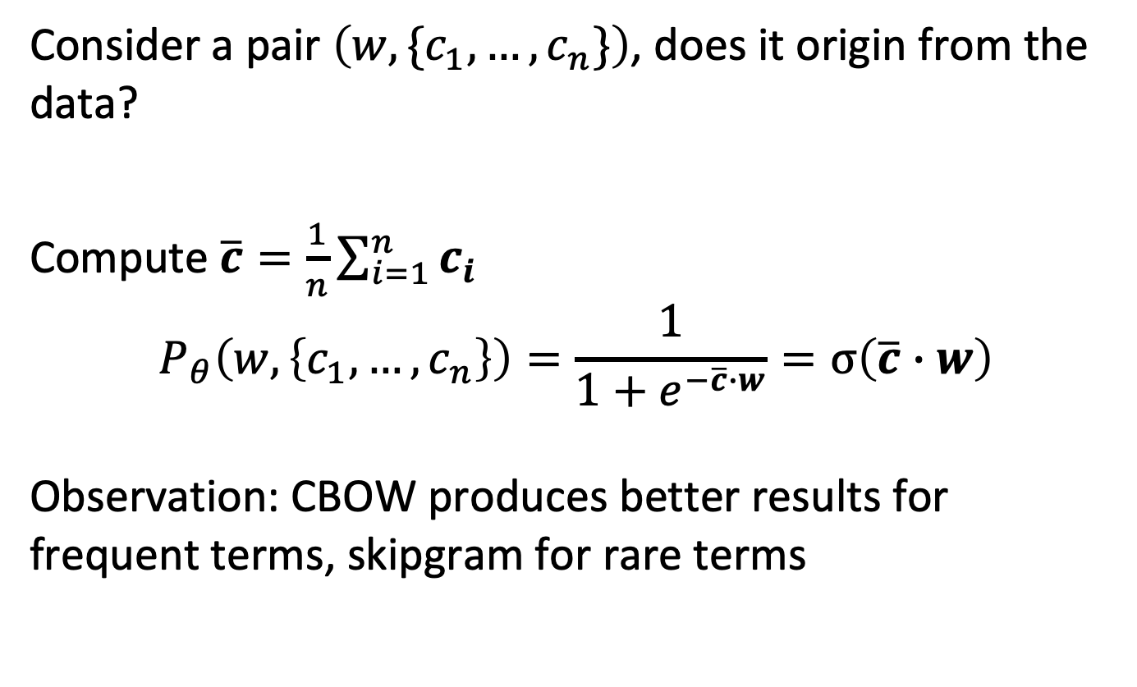
CBOW Model
Consider a pair $\left(w, \{c_{1},…,c_{n}\}\right)$, does it origin from the data?
Compute $\overline{c}=\frac{1}{n}\sum_{i=1}^{n}{c_{i}}$
$$P_{θ}\left(w,\left\{c_{1},…,c_{n}\right\}\right)=\frac{1}{1+e^{−\overline{c}∙w}}=σ\left(\overline{c}∙w\right)$$
Observation: CBOW produces better results for frequent terms, skipgram for rare terms
Notes:
With the skipgram model, we have considered the probability of word-context word pairs as the objective for learning. An alternative approach is to consider the complete context of a word and predict whether a set of context words is likely to occur with a given word. In order to represent a set of words in the embedding model we can choose the mean of the embedding vectors of the context words and require that this vector is similar to the embedding vector of center word, if this specific selection of context words appears with the center word in the document collection. The remaining aspects of the method remain the same. This alternative model is called CBOW. Empirical evaluations show that skipgram gives better representations for rare terms.

Slide 36
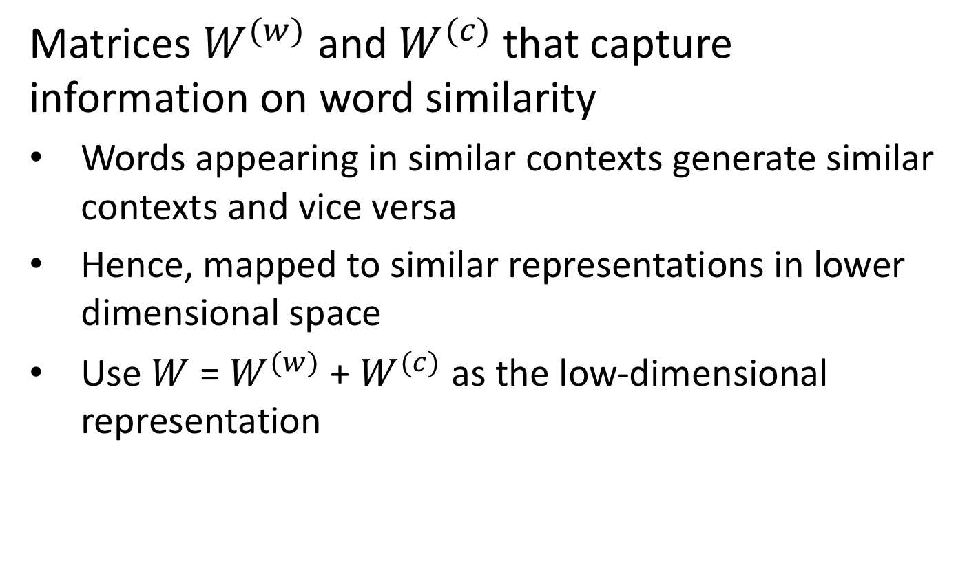
Result
Matrices $W^{(w)}$ and $W^{(c)}$ that capture information on word similarity
Words appearing in similar contexts generate similar contexts and vice versa
Hence, mapped to similar representations in lower dimensional space
Use $W$ = $W^{(w)}$ + $W^{(c)}$ as the low-dimensional representation
Notes:
By using skipgram or CBOW we obtain two models mapping words into a low dimensional space corresponding to the two roles words can take, center words or context words. In practice, a final model is derived as the sum of the two matrices.

Slide 37
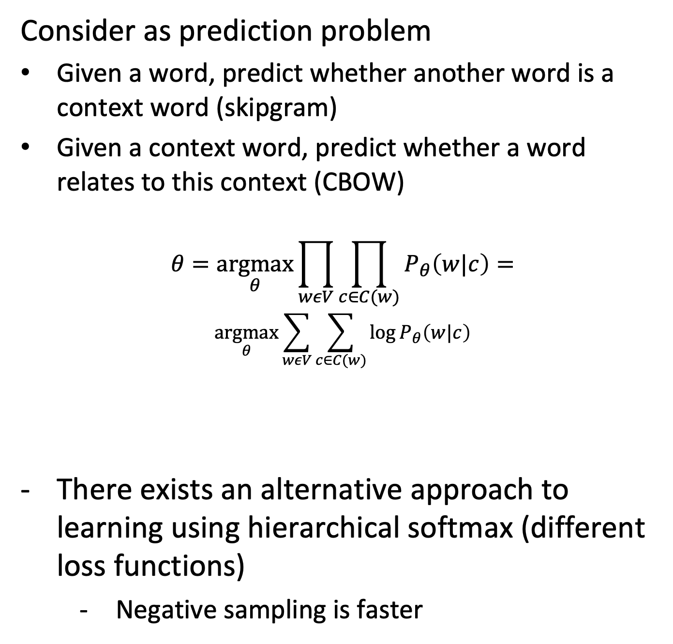
Alternative Formulation of the Problem
Consider as prediction problem
Given a word, predict whether another word is a context word (skipgram)
Given a context word, predict whether a word relates to this context (CBOW)
$$θ=\underset{θ}{argmax}{\prod_{wεV}{\prod_{c∈C(w)}{P_{θ}\left(w|c\right)}}}=$$
$$\underset{θ}{argmax}\sum_{wεV}{\sum_{c∈C(w)}{\log{P_{θ}\left(w|c\right)}}}$$
There exists an alternative approach to learning using hierarchical softmax (different loss functions)
Negative sampling is faster
Notes:
The original formulation of the skipgram and CBOW models used a different approach. Instead of predicting the independent probabilities of occurrences of word-context pairs, it models the conditional probability of having a context word given a word (skipgram), respectively of having a word given a context word (CBOW). Using these conditional probabilities, a different optimization objective can be formulated, optimizing the observed conditional probabilities of word-context word occurrences.

Slide 38
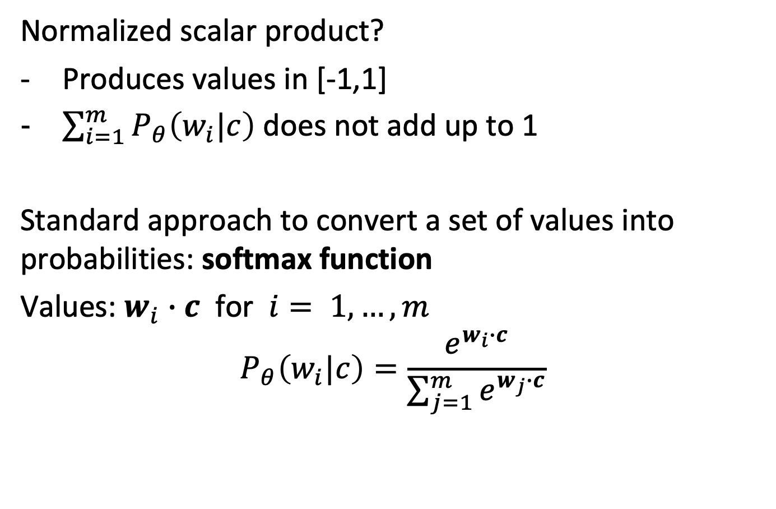
Deriving Probabilities
Normalized scalar product?
Produces values in [-1,1]
$\sum_{i=1}^{m}{P_{θ}\left(w_{i}|c\right)}$ does not add up to 1
Standard approach to convert a set of values into probabilities: softmax function
Values: $w_{i}∙c$ for $i= 1,…,m$
$$P_{θ}\left(w_{i}|c\right)=\frac{e^{w_{i}∙c}}{\sum_{j=1}^{m}{e^{w_{j}∙c}}}$$
Notes:
For introducing a function that derives those conditional probabilities from the vector representation of words while using the scalar product, in addition to the problem that the values of the scalar product do not fall into the interval [-1, 1], we find the additional problem that the conditional probabilities for a given context word (CBOW) do not add up to 1.
To address this issue, there exists a standard approach to convert an (arbitrary) set of values into a probability distribution. First, applying the exponential function to the set of values (in our case the scalar products), produces positive values only, and second normalizing by the sum of the exponentials lets the values fall into the interval [0,1].

Slide 39
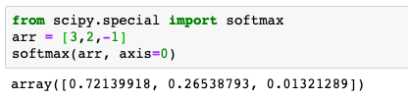
Illustration
Banking (word)
Crisis (context word)
Debt (context word)
Banking • Crisis = +3
Banking • Debt= +2
Banking • Monkey = -1
P(Banking, Crisis) = 0.72
P(Banking, Debt= 0.27
P(Banking, Monkey) = 0.01
Monkey (context word)
Notes:
Applying the softmax function to the scalar products, produces now a probability distribution for a context word, co-occurring with some word of the vocabulary.

Slide 40
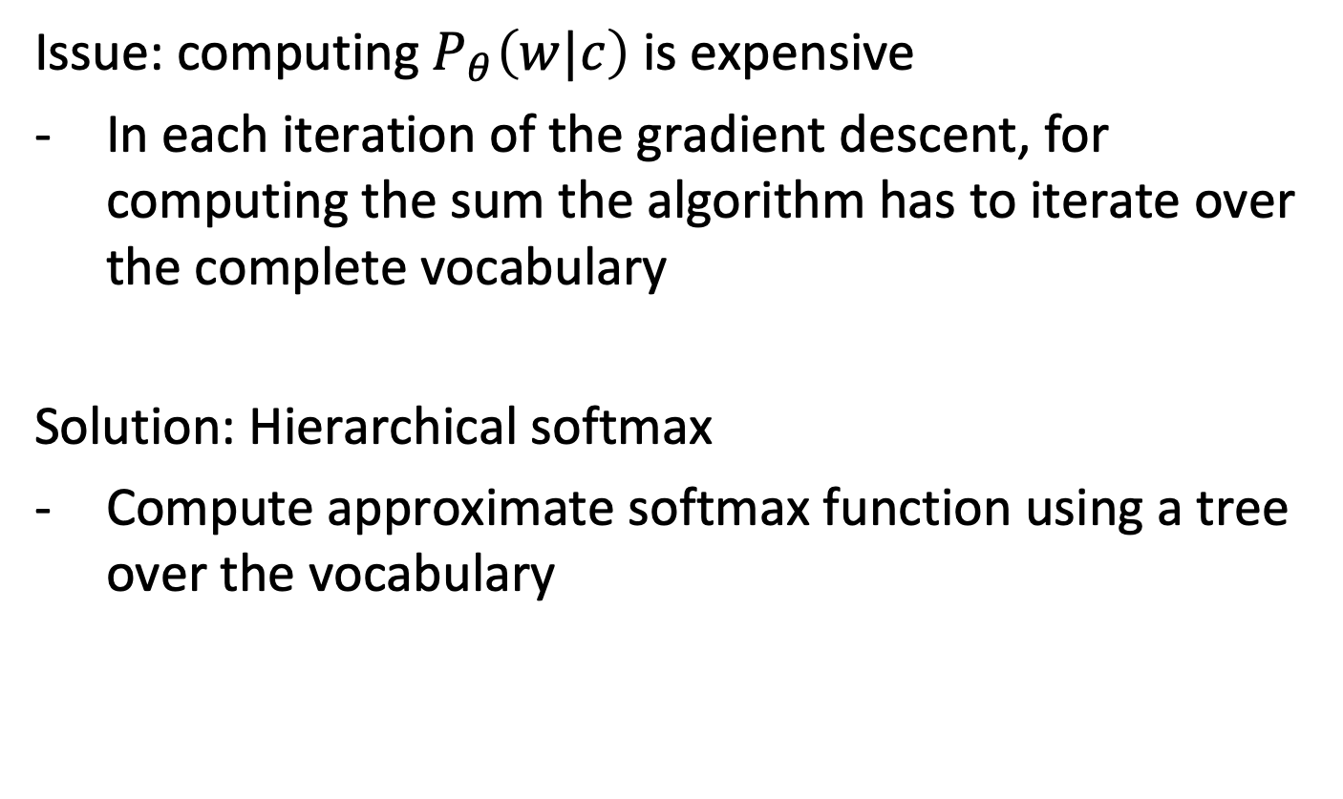
Hierarchical Softmax
Issue: computing $P_{θ}\left(w|c\right)$ is expensive
In each iteration of the gradient descent, for computing the sum the algorithm has to iterate over the complete vocabulary
Solution: Hierarchical softmax
Compute approximate softmax function using a tree over the vocabulary
Notes:
The issue with this variant of the loss function is that in the gradient descent the sums of the conditional probabilities $\sum_{i=1}^{m}{P_{θ}\left(w_{i}|c\right)}$ have to be computed repeatedly which is prohibitively expensive. The solution to this problem is an approach called hierarchical softmax which performs an approximate computation of those sums using a tree-structure to organize the vocabulary.

Slide 41
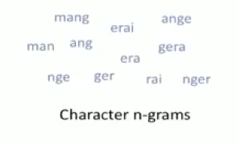
1.4.4 Fasttext
Fasttext introduces the idea of using word n-grams (phrases) and subword embeddings
Build embeddings for character n-grams
Enable processing of unseen words
Example (in French): mangerai
Notes:
The word embedding models we have presented where based on the assumption that the vocabulary consists of the words found in the text corpus. Fasttext is a variant of word embeddings that has been developed by Facebook research. It incorporates two additional ideas:
The use of word n-grams, respective phrases: often phrases carry a different meaning than their constituent words. Considering phrases (that are sufficiently frequent) can help to produce better representations of text and capture meaning that cannot be assigned to the constituents of the phrase. As an extreme example one might consider the phrase “The Who” which designates a rock band, whereas the constituent words have no meaning that would be related to music in any way.
The use of character n-grams: many languages with a writing system based on an alphabet, e.g., Latin languages, have word variations with similar meanings resulting from grammatical rules. Often some variations might not occur in a training corpus. By using so-called subword embeddings the meaning identified for seen words, can so be transferred also to unseen works. This also works across languages, as often languages inherit expressions from foreign languages, or words are same or similar across different languages.

Slide 42
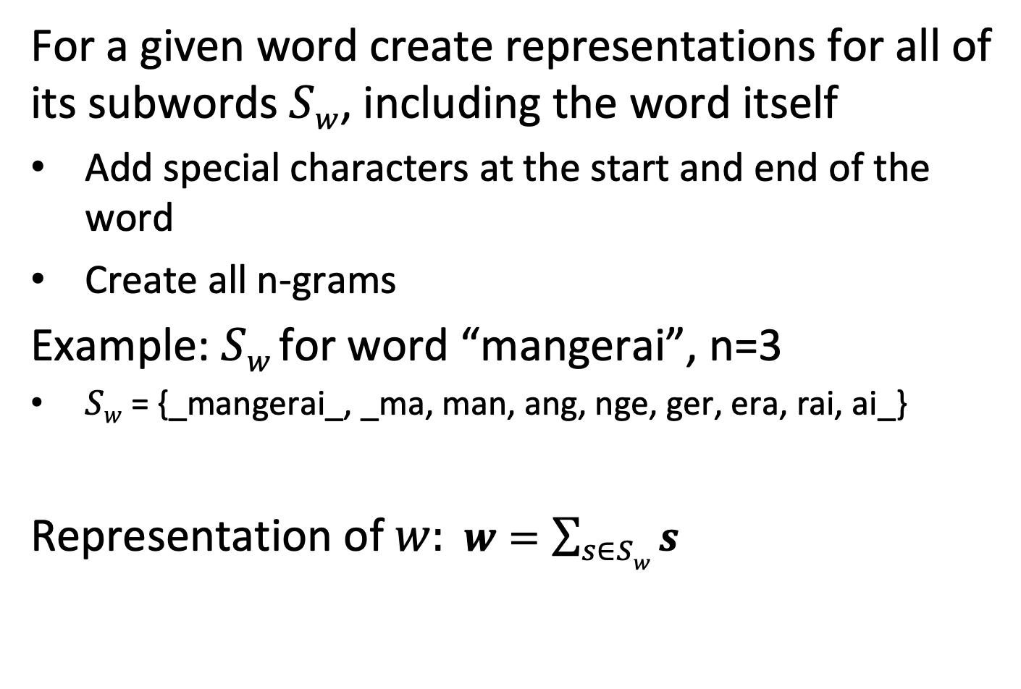
Subword Embeddings
For a given word create representations for all of its subwords $Sw$, including the word itself
Add special characters at the start and end of the word
Create all n-grams
Example: $Sw$for word “mangerai”, n=3
$Sw$ = {_mangerai_, _ma, man, ang, nge, ger, era, rai, ai_}
Representation of $w: w=\sum_{s∈Sw}{s}$
Notes:
When using subword embeddings, the representation of a word is aggregated from the representation of its constituent n-grams, by adding up the n-gram representations.

Slide 43
Byte Pair Encoding (BPE)
Subword embeddings potentially generate large numbers of possible tokens, many of which are not useful
Large vocabulary implies training the model becomes expensive
BPE allows to create smaller vocabularies, while capturing essential subword information
Statistically analyze text for frequent character sequences
Replace frequent sequences by tokens
Notes:
When using subword embeddings with character n-grams one faces the problem that the number of tokens, i.e., the size of the vocabulary, may become very large when all character n–grams occurring in the text are used. This in turn makes training the models very expensive. In addition, many of the tokens are rare and potentially not very useful. In order to address this problem, a method called byte pair encoding is used in order to obtain smaller vocabularies and select only frequent subwords. For this method, first the text needs to be analyzed to determine the frequent tokens.

Slide 44
Example
“Do Do! Do! Do! Do? Do! Done Done! Done? Done.”
What are good tokens?
All subwords of size n=2,3,4,5 {Do, o!, o?, o., on, ne, e!, e?, e., Do!, Do?, …}
Better solution
{Do, Do!, Done, !, ?, .}
Tokenized text:
[Do, Do!, Do!, Do!, Do, ?, Do!, ., Done, Done, !, Done, ?, Done, .]
Notes:
This example illustrates the idea of BPE. Instead of blindly selecting all character n-grams, a carefully selected set of frequent n-grams is chosen and used to tokenize the text.

Slide 45
BPE Algorithm
Add word boundaries
“Do_Do!_Do!_Do!_Do?_Do!_Done_Done!_Done?_Done.”
Initial Vocabulary V = all characters
while i < max_iterations
determine a most frequent pair of tokens
add pair to V as a new token
update token frequencies
i = i+1
Notes:
For running the BPW algorithm first a special token for word boundaries is added (in this example _).
The BPE algorithm proceeds iteratively. It determines in every iteration a most frequent pair of tokens and creates from this pair a new token. Then token frequencies are updated with the new set of tokens. The algorithm terminates after a predetermined number of tokens has been created.
In order to determine token frequencies without repeatedly scanning the text, the algorithm can initially scan the document collection to determine all n-gram frequencies (up to a given size).

Slide 46
BPE Example
Do_Do!_Do!_Do!_Do?_Do!_Done_Done!_Done?_Done.
V = {_, D, o, !, ?, n, e, .}
i = 1, most frequent pair: Do with frequency 9
V = {_, D, o, !, ?, n, e, ., v₀ = Do}
New text: v₀ _v₀!_v₀!_v₀!_v₀?_v₀ ne_v₀ ne!_v₀ ne?_v₀ ne.
i = 2: most frequent pair: !_ with frequency 5
V = {_, D, o, !, ?, n, e, ., v₀ = Do, v₁ = !_}
New text: v₀ _v₀ v₁ v₀ v₁ v₀ v₁ v₀?_v₀ ne_v₀ ne v₁ v₀ ne?_v₀ ne.
i = 3: most frequent pair: v₁ v₀ with frequency 4 (or ne with frequency 4)
Notes:
Here we illustrate the first two steps of the algorithm. Having tokens that combine a character n-gram with a word boundary is important to identify character sequences that would typically occur at the end (or beginning) of a word and to distinguish them from character sequences that occur in the middle of a word.
For example, the sequence “ed” at the end of of an English word (like “worked”) implies a different meaning of this character sequences at the beginning of a word (like “education”) or in the middle of a word (like “medicine”)

Slide 47
Question
Fasttext speeds up learning by
Considering subwords of words
By selecting the most frequent phrases in the text as tokens
By selecting the most frequent subwords in the text as tokens
By pre-computing frequencies of n-grams

Slide 48

1.4.5 Glove
GLOVE is based on the following analysis
Consider two terms, with similar, but related meaning: ice, steam
Determine the conditional probability $P(x|ice)$, $P(x|steam)$of other terms $x$ to co-occur within a window
Determine the ratio of these two conditional probabilities
Notes:
The skipgram and CBOW models are one variant among several similar models that have been proposed recently to create word representations that capture word semantics.
One popular model is GLOVE, which is based on the observation that ratios of probabilities of co-occurrence can be used to capture more accurately semantic relationships among terms.

Slide 49
1.4.5 Glove
Observation: ratio captures additional information
“solid” is related to “ice” but unrelated to “steam”: we expect a larger ratio of co-occurrence probabilities
“gas” is related to “steam” but unrelated to “ice”: we expect a smaller ratio of co-occurrence probabilities
”water” is related to both “ice” and “steam”: we expect a ratio of co-occurrence probabilities that is close to 1 (both large)
A random word that is unrelated to both “ice” and “steam”: we expect a ratio of co-occurrence probabilities that is close to 1 (both small)
Notes:
In this example, the term solid is much more likely to co-occur with ice, than with water, and similarly steam co-occurs much more likely with gas than with ice. On the other hand, water co-occurs frequently with both. In the Glove paper it is stated: “Compared to the raw probabilities, the ratio is better able to distinguish relevant words (solid and gas) from irrelevant words (water and fashion) and it is also better able to discriminate between the two relevant words”.

Slide 50
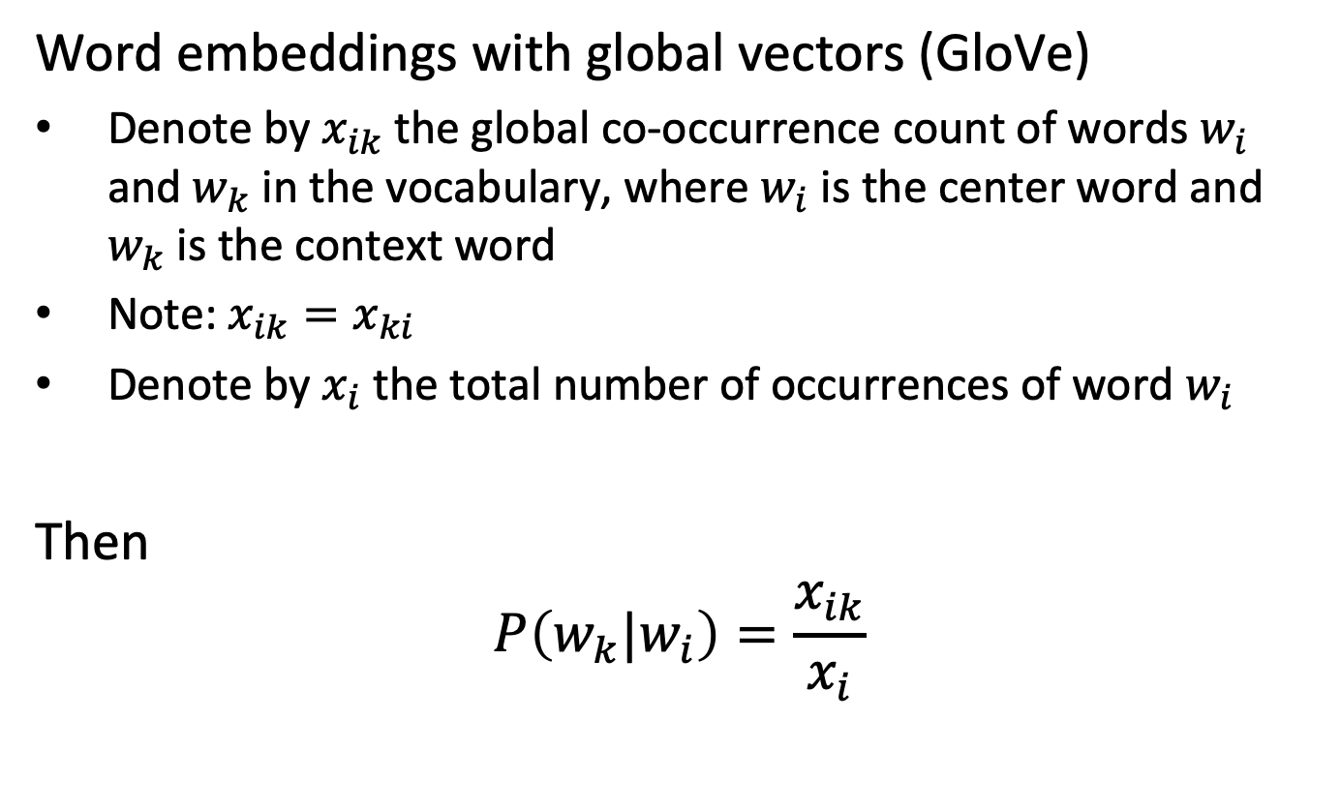
Global Co-occurrence Count
Word embeddings with global vectors (GloVe)
Denote by $x_{ik}$ the global co-occurrence count of words $w_{i}$ and $w_{k}$ in the vocabulary, where $w_{i}$ is the center word and $w_{k}$ is the context word
Note: $x_{ik}=x_{ki}$
Denote by $x_{i}$ the total number of occurrences of word $w_{i}$
Then
$$P\left(w_{k}|w_{i}\right)=\frac{x_{ik}}{x_{i}}$$
Notes:
In order to consider the property illustrated before, Glove uses the global co-occurrence counts among words within a window. In this way, it incorporates into the model a global statistics on the co-occurrence of words, different to skipgram/CBOW which iterate over the different occurrences while learning the parameters.
Using the global co-occurrence counts we can determine a co-occurrence probability.

Slide 51
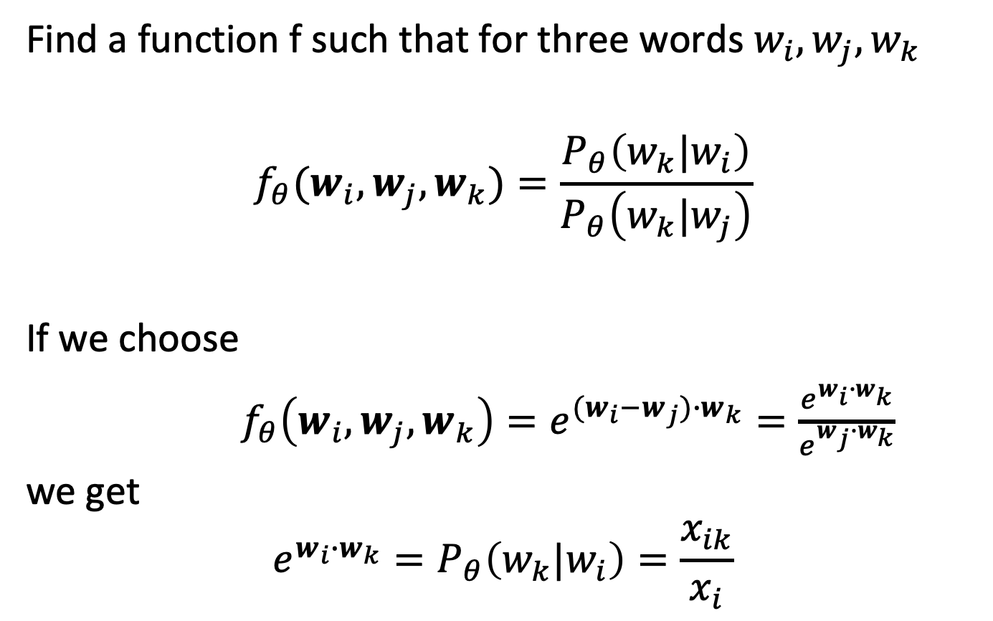
Modeling Ratios
Find a function f such that for three words $w_{i},w_{j},w_{k}$
$$f_{θ}(w_{i},w_{j},w_{k})=\frac{P_{θ}\left(w_{k}|w_{i}\right)}{P_{θ}\left(w_{k}|w_{j}\right)}$$
If we choose
$f_{θ}\left(w_{i},w_{j},w_{k}\right)=e^{{(w}_{i}−w_{j})∙w_{k}}=\frac{e^{w_{i}∙w_{k}}}{e^{w_{j}∙w_{k}}}$
we get
$$e^{w_{i}∙w_{k}}=P_{θ}\left(w_{k}|w_{i}\right)=\frac{x_{ik}}{x_{i}}$$
Notes:
In order to formalize the observation that we have described, we need to design a function that models ratios between co-occurrence probabilities derived from their vector representations. In Glove this function is chosen to be of the form of an exponential of the scalar product of the difference of the representation of two (context) words with the representation of a given word. With this function, it follows that the conditional probability of co-occurrence is modelled as the exponential of the scalar product of the representations of the two words.

Slide 52
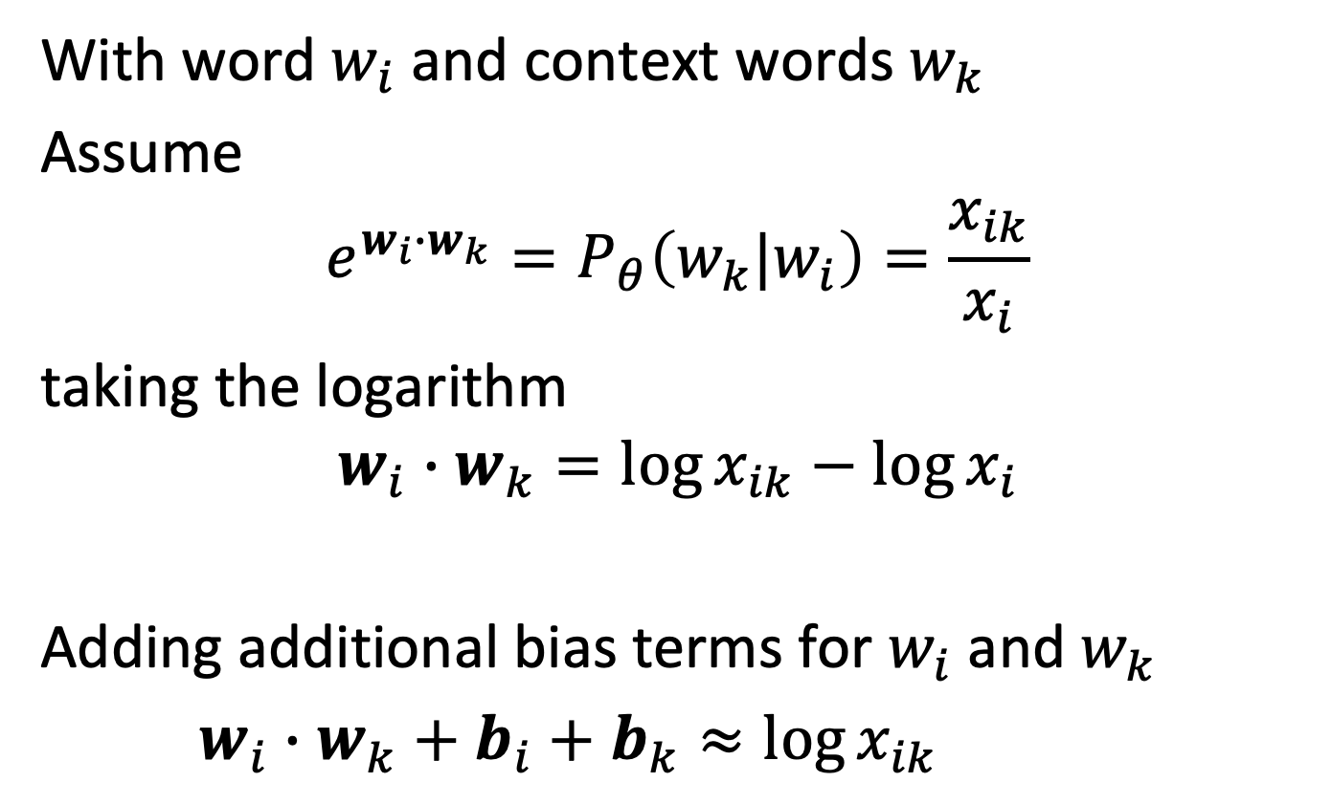
Glove Loss Function
With word $w_{i}$ and context words $w_{k}$
Assume
$$e^{w_{i}∙w_{k}}=P_{θ}\left(w_{k}|w_{i}\right)=\frac{x_{ik}}{x_{i}}$$
taking the logarithm
$$w_{i}∙w_{k}=\log{x_{ik}−\log{x_{i}}}$$
Adding additional bias terms for $w_{i}$ and $w_{k}$
$w_{i}∙w_{k}+b_{i}+b_{k}≈\log{x_{ik}}$
Notes:
Based on the function we have chosen to represent the conditional probability of word cooccurence, we can derive a loss function. By taking the logarithm we obtain a linear relationship between the scalar product and the co-occurrence statistics. By adding so-called bias terms, which correspond to additional vector representations of the words, we obtain a relationship between the word embedding vectors and the co-occurrence probabilities. Note that by adding a bias term $b_{i}$ the term $\log{x_{i}}$ is considered in this relationship.

Slide 53
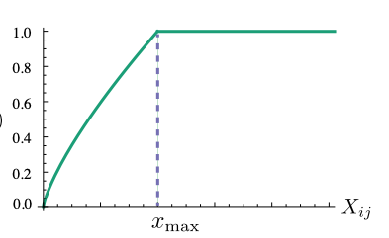
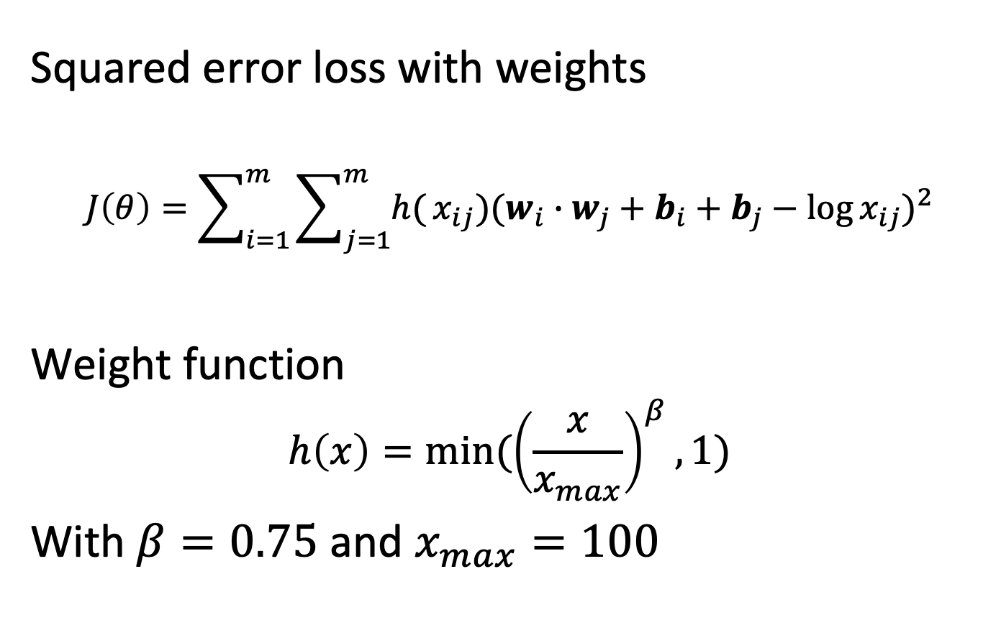
Glove Loss Function
Squared error loss with weights
$$J\left(θ\right)=\sum_{i=1}^{m}{\sum_{j=1}^{m}{h(}}x_{ij}){(w_{i}∙w_{j}+b_{i}+b_{j}−\log{x_{ij}})}^{2}$$
Weight function
$$h\left(x\right)={min⁡(\left(\frac{x}{x_{max}}\right)}^{β},1)$$
With $β=0.75$ and $x_{max}=100$
Notes:
Based on the relationship introduced, a loss function is derived. In the case of Glove, the squared error is used. In addition, a weighting function $h$ is introduced to address two problems:
If $x_{ij}$ equals zero, the loss function would be ill-defined. The limit $\lim_{x→0}{h(x) log⁡^2(x)}⁡$is finite, making the function well-defined
Small values of $x_{ij}$ carry in general less information and should thus have lower weight.

Slide 54
Question
The most important difference between Glove and skipgram is
That Glove considers the complete context of a word
That Glove computes a global frequency for word-context pair occurrences
That Glove uses a squared error loss function
That Glove does not differentiate words and context words

Slide 55
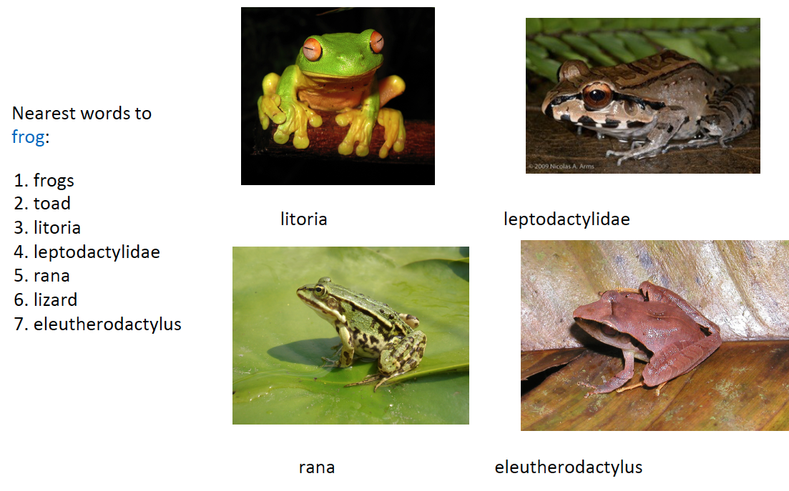
Glove: Nearest words to Frog
Notes:
A first property is that similar words are grouped together. Here is a nice example, produced with Glove, that illustrates the point. (The underlying data is from Wikipedia).

Slide 56
Syntactic Relationships
Notes:
Word embeddings also capture syntactic relationships, like singular-plural or comparative and superlative, as shown here. This type of visualizations is obtained by projecting from the d-dimensional word embedding space (appropriately) into a 2-dimensional space.

Slide 57
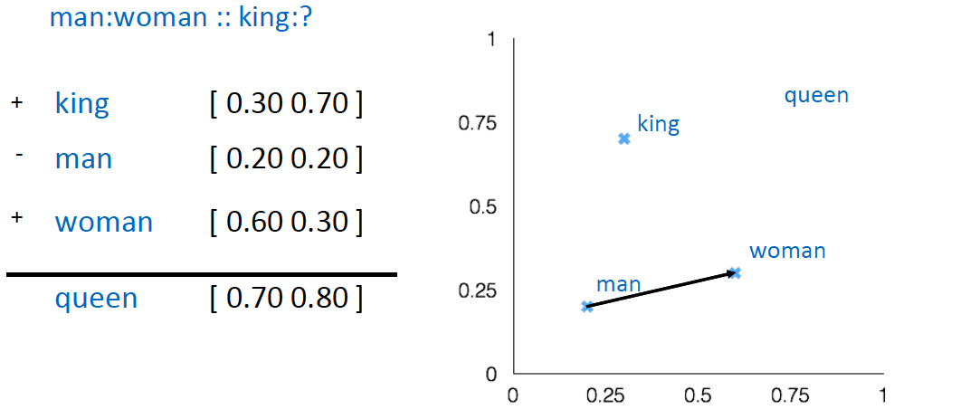
Word Analogies: semantic relationships
Notes:
Even more interestingly, word embeddings enable “computing” with relationships (this is called the word analogy task). Analogies translate into linear mappings! We will later exploit this property for extracting relationships from text.

Slide 58
Semantic Dimensions
negative
natural
positive
artificial
Notes:
Furthermore, word embeddings can capture semantic meaning in dimensions. In this example, data on nutrition has been analyzed and terms indicating qualities of foods are extracted. The word embedding clearly organizes it according to properties that are human understandable, e.g. natural vs. artificial ingredients.

Slide 59
Properties of Word Embeddings
Similar terms are clustered
Syntactic and semantic relationships encoded as linear mappings
Dimensions can capture meaning
Notes:
We summarise some of the main properties of word embeddings.

Slide 60
Use of Word Embedding Models
Document Search
Use word embedding vectors as document representation
Thesaurus construction and taxonomy induction
Search engine for semantically analogous / related terms
Document classification
Use of word embedding vectors of document terms as features
Notes:
Word embeddings have beyond retrieval a wide range of applications.

Slide 61
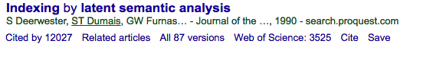





Impact
Latent semantic indexing
Latent Dirichlet allocation
Word embeddings
+2000
+8000
+8000

Slide 62
References
Relevant articles
Mikolov, Tomas, et al. "Distributed representations of words and phrases and their compositionality." Advances in neural information processing systems. 2013.
Goldberg, Yoav, and Omer Levy. "word2vec explained: Deriving mikolov et al.'s negative-sampling word-embedding method." arXiv preprint arXiv:1402.3722 (2014).
Pennington, Jeffrey, Richard Socher, and Christopher D. Manning. "Glove: Global vectors for word representation." Proceedings of the 2014 conference on empirical methods in natural language processing (EMNLP). 2014.

